Slide 1
ATC Counter-Terrorism
Module 4: TPIMs

Slide 2
TERRORISM PREVENTION AND INVESTIGATION MEASURES
MARK II
PREVENTION OF
TERRORISM ACT
2011
2021
2005
2015
COUNTERTERRORISM AND
SENTENCING BILL
MEND - ATC COUNTER-TERROR
TERRORISM PREVENTION AND INVESTIGATION MEASURES
MARK I

Slide 3
Prevention of Terrorism Act (PTA) 2005
‘Control orders’.
To prevent terrorism-related activity by individuals:
(a) Derogating
(b) Non-derogating
MEND - ATC COUNTER-TERROR

Slide 4
Use of specified services and/or facilities.
Certain occupations/
employment
Restriction of place of residence &
visitors to the residence.
Passport must be surrendered.
MEND - ATC COUNTER-TERROR
A requirement to allow electronic surveillance to be carried out and photographs taken.
Any other restrictions whatsoever for up to 24hrs, when it is deemed necessary.

Slide 5
Criticisms of PTA
Rely on'secret' evidence
Orders can be renewed indefinitely
Breach of Article 5 of the European Convention on Human Rights: Right to Liberty
MEND - ATC COUNTER-TERROR
Notes:
Control orders are issued in closed court hearings that neither the defendant nor their lawyer is allowed to attend.
Effectively this means that people are punished indefinitely, without charge or trial, on the basis of secret evidence that they are not permitted to hear or contest. In this sense control orders operate outside the criminal justice system, bypassing due judicial process and undermining the fundamental democratic tenets of the presumption of innocence and the right to a fair trial.

Slide 6
The Terrorism Prevention and Investigation Measures (TPIMs)
Introduced in 2011
Authorities monitor and control people considered to be terrorists (but not facing criminal charges)
MEND - ATC COUNTER-TERROR

Slide 7
TPIMs Mark I - 2011
Briefer periods of house arrest & did not allow forced relocation.
Limited restriction on a suspect’s movement, communication, and property.
Can only be imposed for a two-year maximum period.
MEND - ATC COUNTER-TERROR

Slide 8
TPIMs Mark II - 2015
TPIMs Mark I: under-used so must be strengthened
Some of the measures from ‘control orders’ were reinstated; forced relocation and restrictions on travels.
Lowering the Standard of Proof
Removing the Two-Year Time Limit
MEND - ATC COUNTER-TERROR

Slide 9
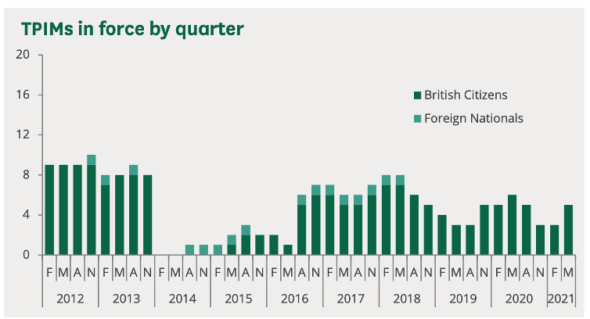
MEND - ATC COUNTER-TERROR
There are currently five TPIMs in force as of 31 May 2021.

Slide 10
Case study 1 : DD
2012 - 2015: Government imposed TPIMs notice on DD
Must wear an electronic monitoring device.
2015: a British judge found that DD’s rights under Article 3 of ECHR were breached.
DD suffered from mental illness and was granted permission to remove electronic
MEND - ATC COUNTER-TERROR
Notes:
prohibiting inhumane and degrading treatment were breached by this measure

Slide 11
Case study 2: Mohammed Ahmed Mohammed
2011: Placed Mohammed under 'control orders' then TPIMs
Confined to his home, wearing of monitoring device, restricted travel, etc.
2013: Mohamed discarded his electronic tag and fled.
2014: Court of Appeals ruled that his original control order should be quashed
MEND - ATC COUNTER-TERROR

Slide 12
Criticisms of TPIMS
Contradicts the European Convention of Human Rights:
Article 5
Article 8
Article 14
Liberty: unsafe and unfair
JCHR: ineffective

Slide 13
Counter-terrorism & Sentencing Act 2021
Enhanced sentences for those convicted of general criminal offences where terrorism is involved.
Restoring ‘control orders’ in all but name, evidently through:
Longer sentences
Longer licence periods
Tougher tools for monitoring suspects

