Slide 1
ATC Counter-Terrorism
Module 2: PREVENT

Slide 2
Overview
This module aims to understand:
The UK Government's counter-terrorism strategy
How PREVENT looks like in practice
Issues stemming from a lack of evidentary basis to Institutional Islamophobia
Long term impacts of PREVENT on British Muslims
Current Government review of PREVENT
The alternative independent review into PREVENT
MEND - COUNTERTERROR

Slide 3
What is CONTEST?
UK's counter-terror strategy.
Aiming detect radicalisation early, through 4 work-streams:
Prevent
Pursue
Protect
Prepare
MEND - COUNTERTERROR

Slide 4
What is PREVENT
PREVENT is a component of the wider CONTEST strategy
It is delivered nationwide with a particular focus on 'priority' areas
Funding given to PREVENT co-ordinator, who is supported by the Home Office to develop delivery plans relating to PREVENT objectives
Work includes disrupting “extremist” events and speakers, removing material online, intervening to stop people being “radicalised”
MEND - COUNTERTERROR

Slide 5
What does PREVENT mean in practice?
Counter-Terrorism and Security Act 2015 (Section 26): “to have due regard to the need to prevent people from being drawn into terrorism"
Public sector workers have a compulsory duty to report anyone they suspect may be vulnerable to becoming "radicalised"
Once individuals have been identified, they are referred to a programme called CHANNEL or other mainstream services
MEND - COUNTERTERROR

Slide 6
Problems with PREVENT
Operates in pre-criminal spaces which leads to an arbitrary application of the law
Individuals perceived to belong to a community at risk are increasingly problematised, these are often based on religious, cultural or ethnic identities
Consequently, innocent individuals become suspects and are caught up in the apparatus of security measures
PREVENT has thus been heavily criticised by experts, academics, activists, and politicians
MEND - COUNTERTERROR

Slide 7
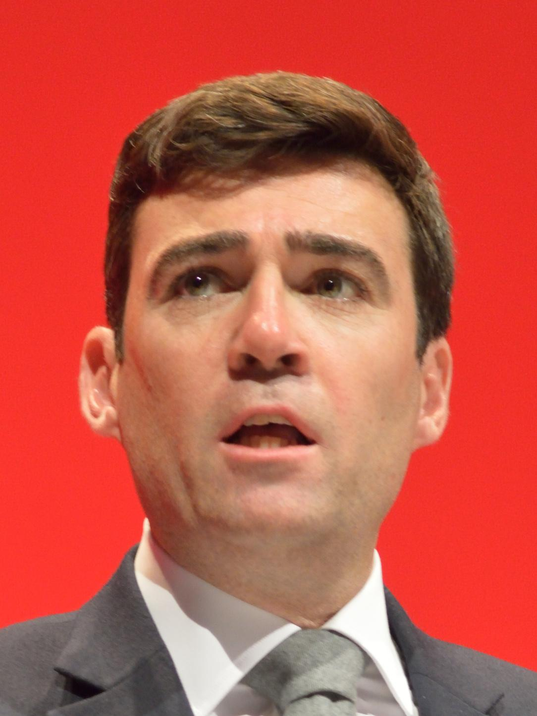
Andy Burnham on PREVENT
“It is creating a feeling in the Muslim community that it is being spied upon and unfairly targeted. It is building a climate of mutual suspicion and distrust. Far from tackling extremism, it risks creating the very conditions for it to flourish.”
MEND - COUNTERTERROR

Slide 8
Problems with PREVENT
Lack of evidentiary basis: reliability issues with research on the Extreme Risk Guidance
Heavy focus on ideology: heavy focus on ideology obscures due consideration of other factors
Lack of viable definitions: leaves public sector workers in a position to determine risk based on subjective biases stereotypes;
Inadequate training: public sector workers often receive only 45-60 mins of online training to identify signs of “radicalisation”.
MEND - COUNTERTERROR

Slide 9
Cosequences of PREVENT
PREVENT's disproportionate impact can have long term consequences. These impacts can be broken down into three major areas:
Children & Primary/Secondary Education
University and Academic Spaces
NHS
MEND - COUNTERTERROR

Slide 10
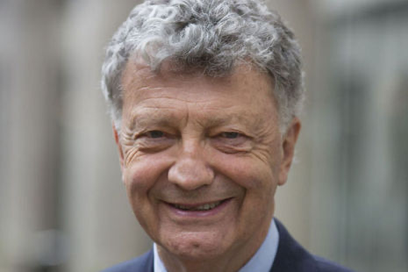
The Shawcross Review & Alternate Review of PREVENT
Review of PREVENT announced in January 2019
William Shawcross appointment as lead of PREVENT Review
Controversial due to his Islamophobic past
17 human rights groups and NGOs have boycotted the Shawcross Review of PREVENT
MEND - COUNTERTERROR

