Slide 1
Radicalisation and Extremism: Understanding the Concepts

Slide 2
Radical? Radicalised? Radicalisation?
What comes to your mind when you hear these terms?
Be brutally honest!

Slide 3
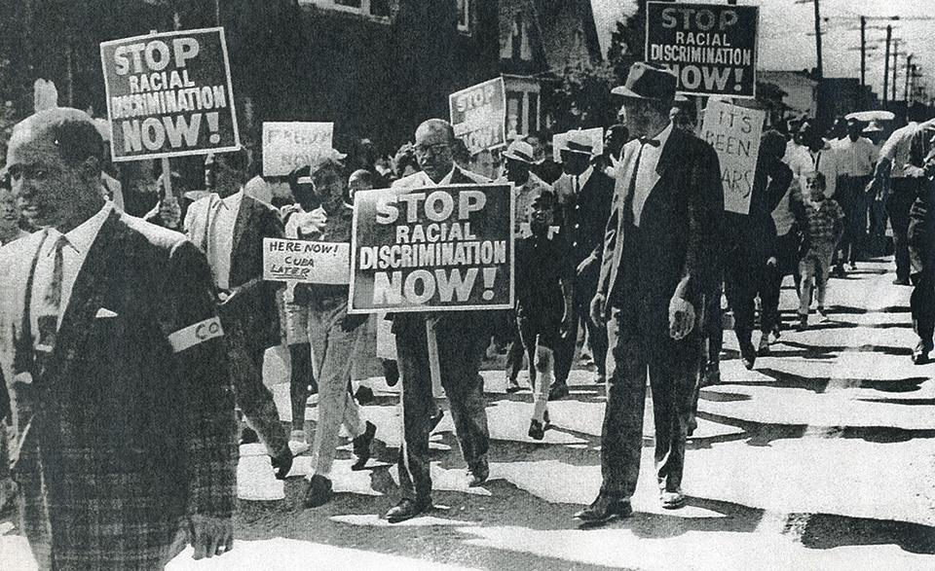
An Evolving Term..
Understandings of the concept have ‘radically’ changed!
Hippies, Civil rights movement, Women's rights movement etc…
A common denominator?

Slide 4
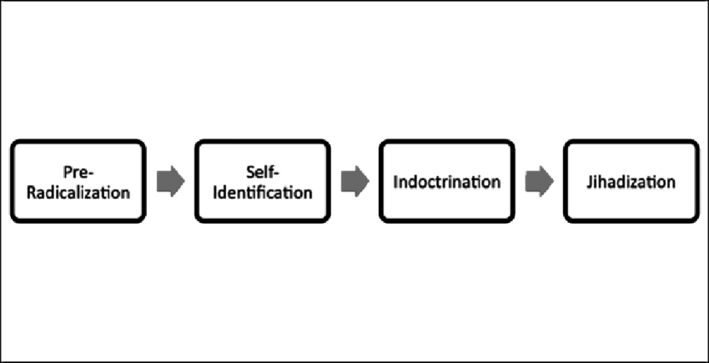
A Post 9/11 Understanding
“The process by which people come to support terrorism and extremism and, in some cases, to then participate in terrorist groups” - UK Government attempt.
“The changes in attitude that lead towards sanctioning, and ultimately, the involvement in the use of violence for political aim” - Academic attempt.

Slide 5
The Reality of ‘Radicalisation’
No consensus on a definition or understanding
Not a science
A highly complex notion
As such:
The notion of ‘Radicalisation’ is a matter of assumption

Slide 6
Extremism and Extremist?
What do the terms ‘extremism’ or ‘extremist’ mean to you?
Again, don’t hold back!

Slide 7
Lack of Specificity
“There is no legal definition of extremism and throughout our engagement and evidence gathering people have told us that it means different things to them.”
- Sara Khan
So what exactly is being identified then?

Slide 8
UK Government Attempt
“Vocal or active opposition to fundamental British values, including democracy, the rule of law, individual liberty and mutual respect and tolerance of different faiths and beliefs. We also include in our definition of extremism calls for the death of members of our armed forces”.
Surely this definition would help narrow the lens, right?

Slide 9
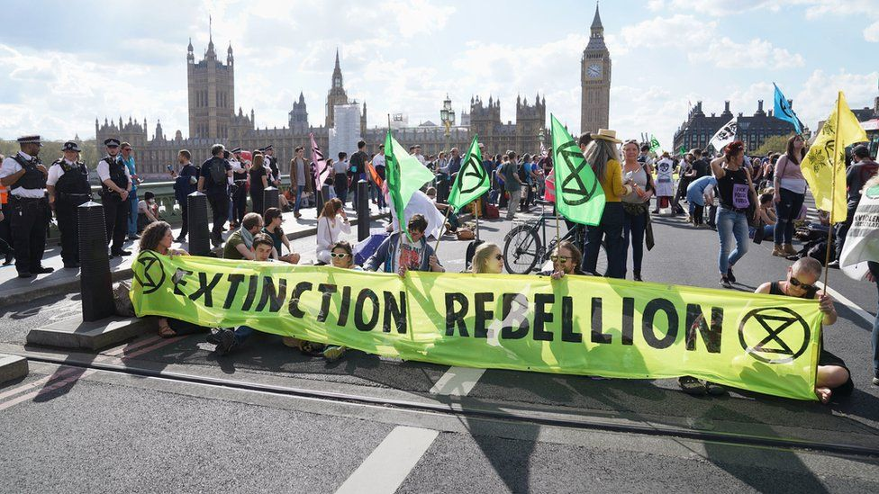
‘Extremists’?
Anti-Brexit activists?
Vegan activists?
Environment activists?

Slide 10
Extremism in Summary
No operable or legal definition
Significant lack of transparency
Can be liberally applied at one's own discretions and prejudices
Conflates harmless and legal acts to potential violence
As such:
It may appear rather futile to label individuals or groups with the heavy conviction that they are ‘extremists’ or ‘potential extremists’ as the subjectivity which surrounds the term provides little justification.

