Slide 1


Notes:
Purpose of training:
To educate attendees on the spectrum of Islamophobia and how to actively combat/ provide support to instances of Islamophobia.
Instruction for Trainee:
Choose a selection of scenarios from scenario bank (slide 8&9)
Consider how much time you have and size of your group
Present each scenario to all participants and provide brief explanation and clarify any questions they may have
Divided participants into small groups (2-8) to discuss only 1 scenario in each group
Allow 7-10 minutes for discussion in each break out group
Instruct each group to select a rep to feedback on group conversation
Each rep will have 1-2minutes to report back
Summaries discussion and use Best practice slides to supplement feedback provided by each group

Slide 2

Notes:
Purpose of slide
To present the definition of Islamophobia.

Slide 3

Hate Crime:
Verbal Attacks
Physical Attacks
Discrimination
Stereotypes
Exclusion
Marginalisation
Notes:
Purpose of slide:
To provide an understanding that Islamophobia has a visible and invisible nature
Key messages:
Many people do not want to use the term Islamophobia but anti-Muslim hatred. This slide explains why this is not the correct term. Anti-Muslim Hatred comprising of verbal and
physical attacks against individuals is only a small part of Islamophobia – it is the iceberg that we can see. However the bigger part of the iceberg that we cannot see are the other types of Islamophobia listed below, which are just as damaging to damages at a community level, e.g. the Prevent Strategy or demonization in the media

Slide 4
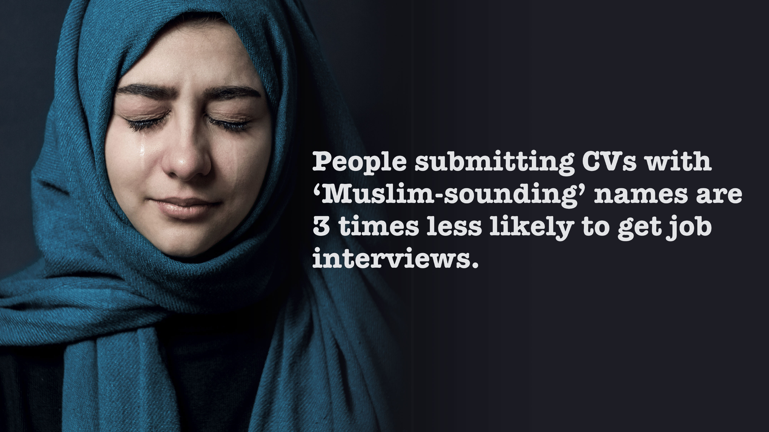

Source: Zack Adesina and Oana Marocico, “Is it easier to get a job if you’re Adam or Mohamed?,” BBC News, February 06, 2017, accessed June 05,2017.
Notes:
Purpose of slide:
Provide an example affecting people at work
Key messages:
BBC did a study and found that ‘People submitting….’

Slide 5
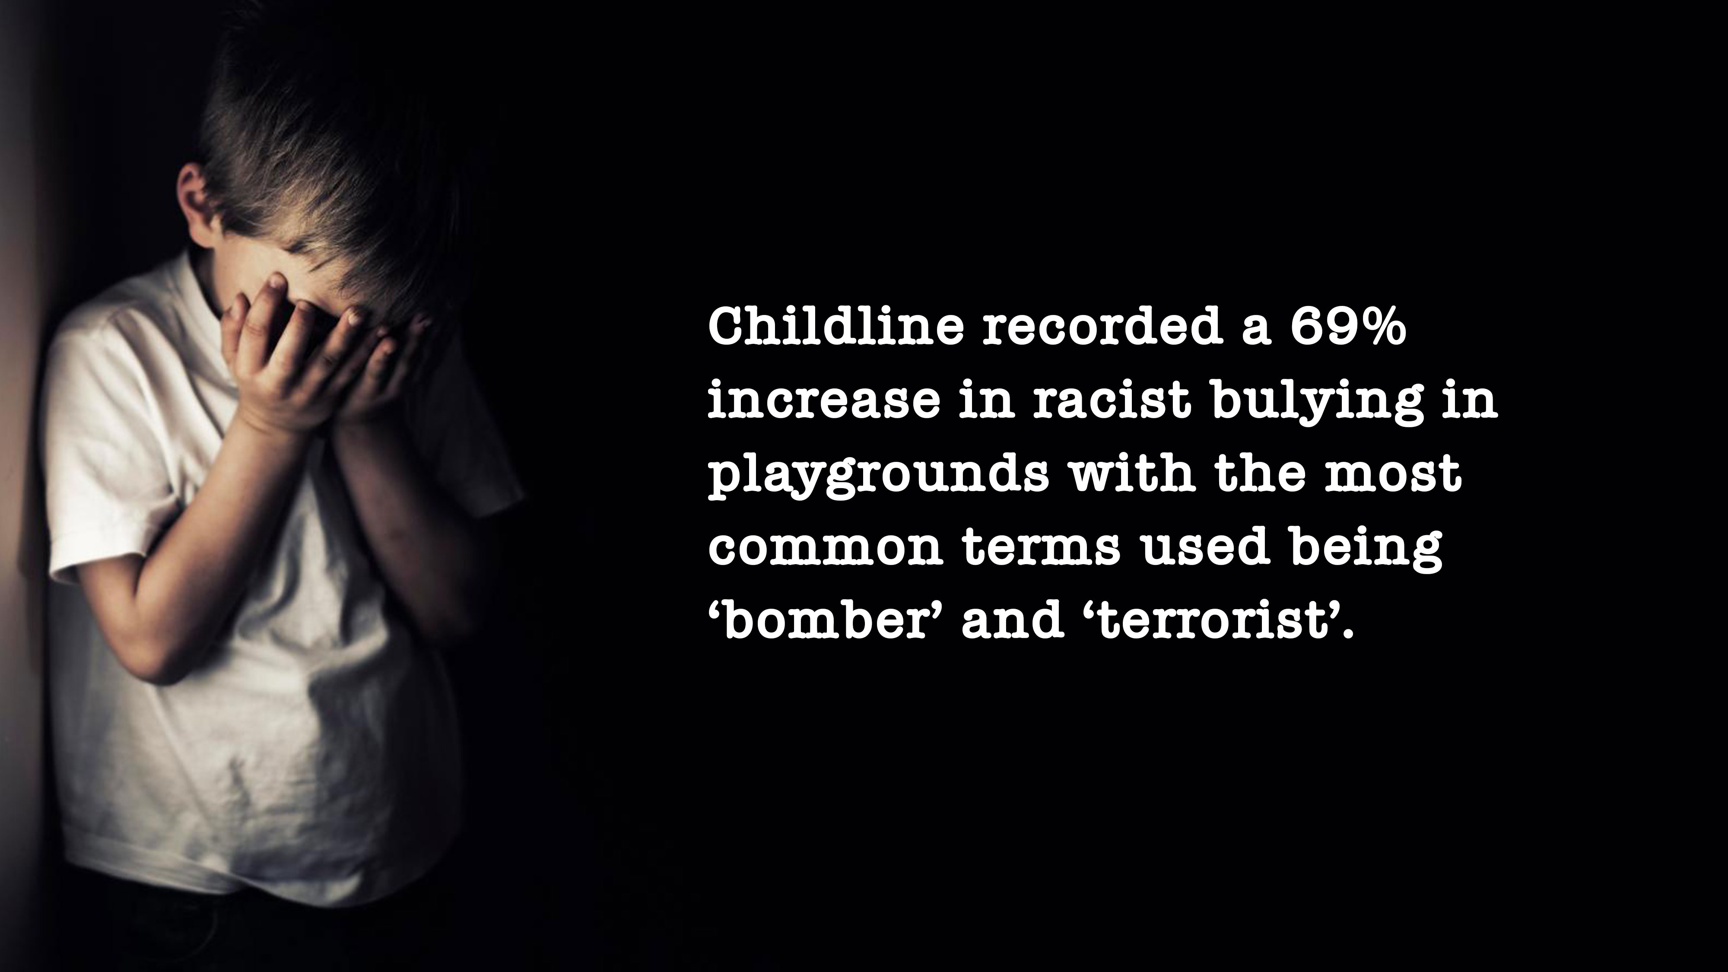
Source: ‘Charity sees rise in race and faith-based bullying’, STV News, 28th June 2017
Notes:
Purpose of slide:
Key messages:
And here are examples of the kind of abuse Muslim children are putting up with . Again how would you feel if that was your child? Now which children do you think have “racist” bullying using these terms? Of course Muslim children, so the term “Racist” bullying here may well be better described as “Islamophobic.”

Slide 6
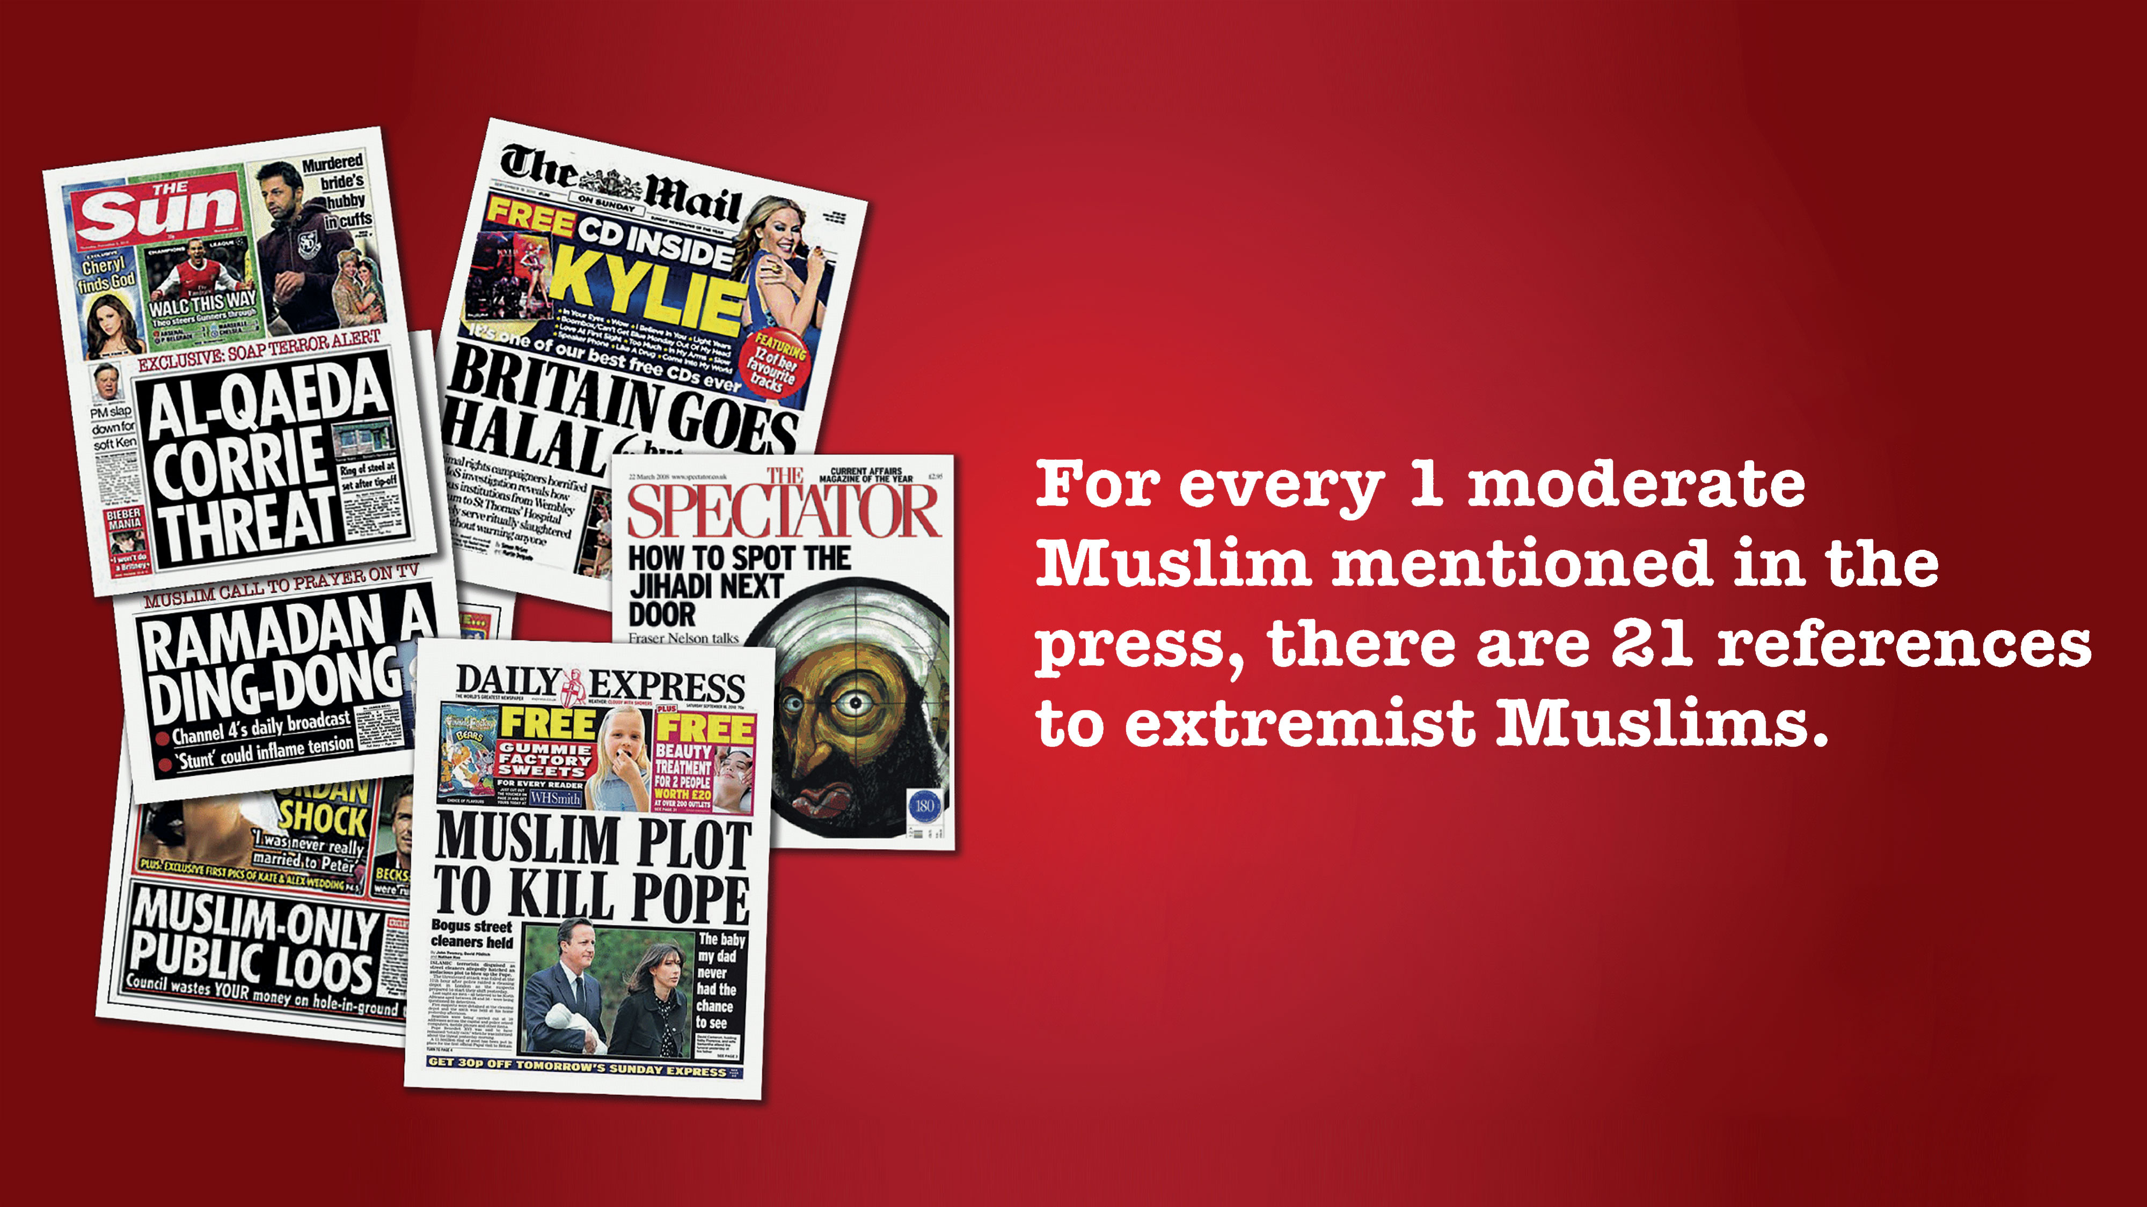
Source: Paul Baker, Costas Gabrielatos, and Tony McEnery, Discourse analysis and media attitudes: the representation of Islam in the British Press (Cambridge: University Press, 2013)
Notes:
Purpose of slide:
To demonstrate the disproportioned nature of negative stories
Key messages:
If I went into a room and 1 person was to say something good about me and 21 said bad things, who would you believe?

Slide 7
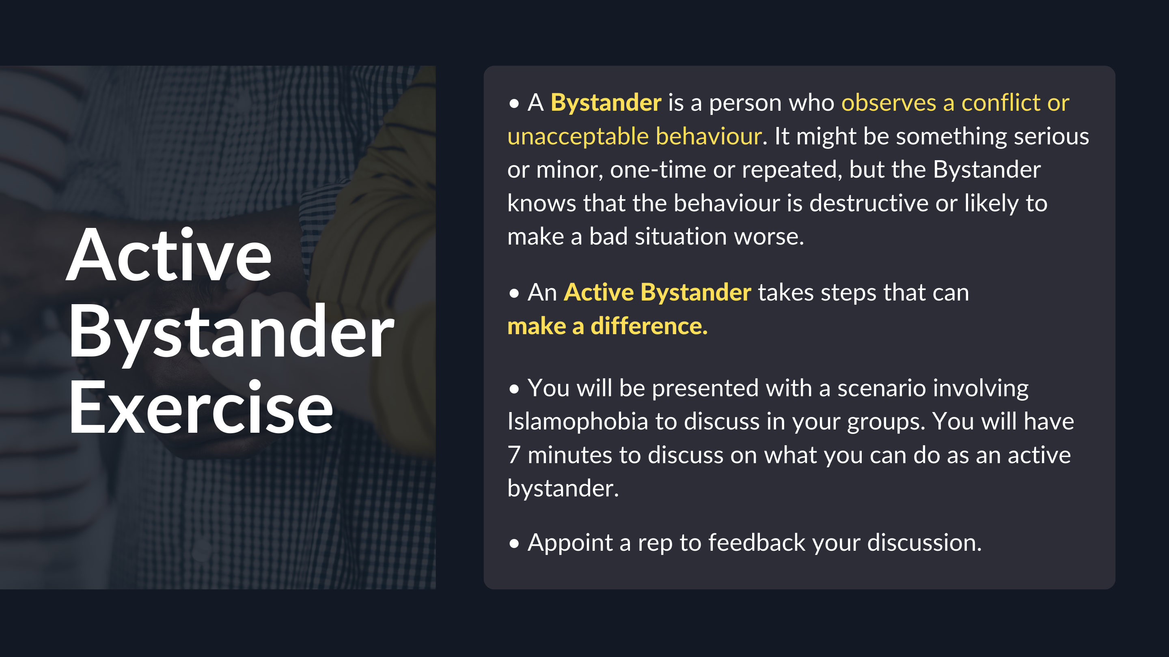
Notes:
Purpose of slide:
To explain the concept of Active Bystander
Key messages:
Explain the definition of Active Bystander, differentiate between Active and passive.

Slide 8
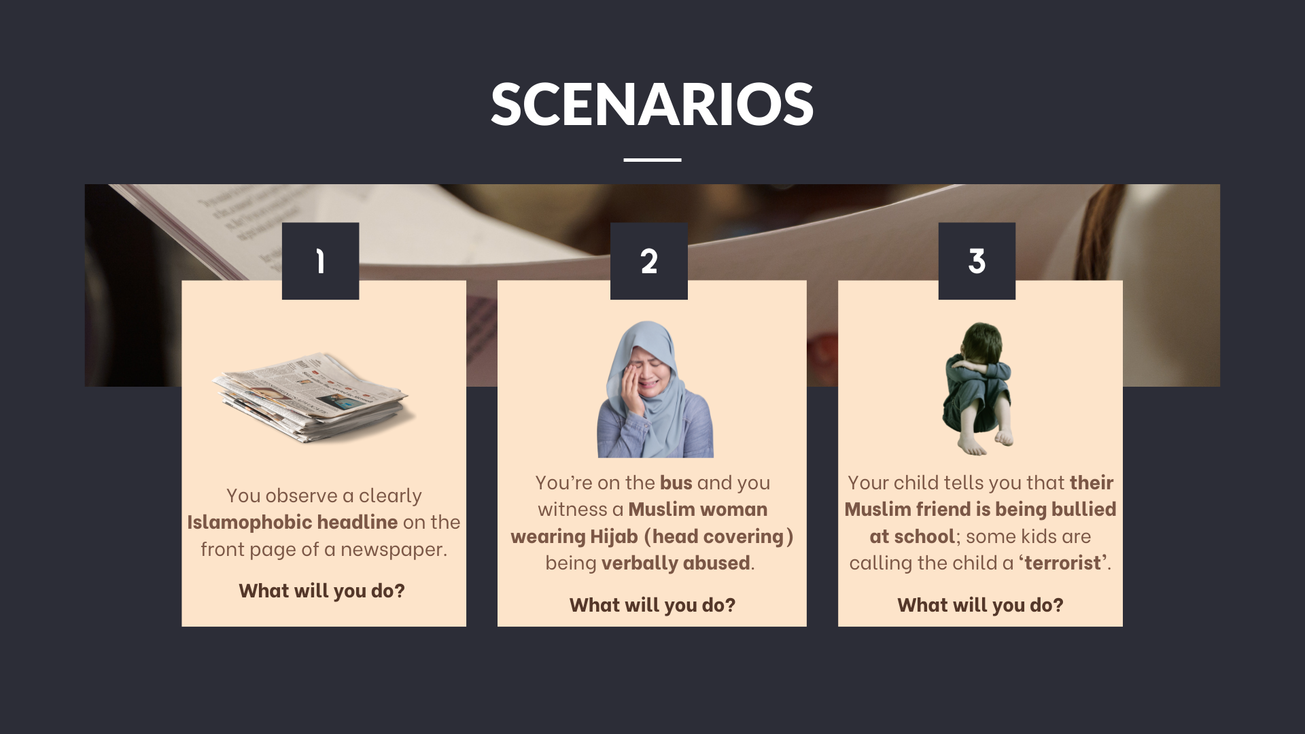
Notes:
Feel free to increase of reduce the scenarios

Slide 9
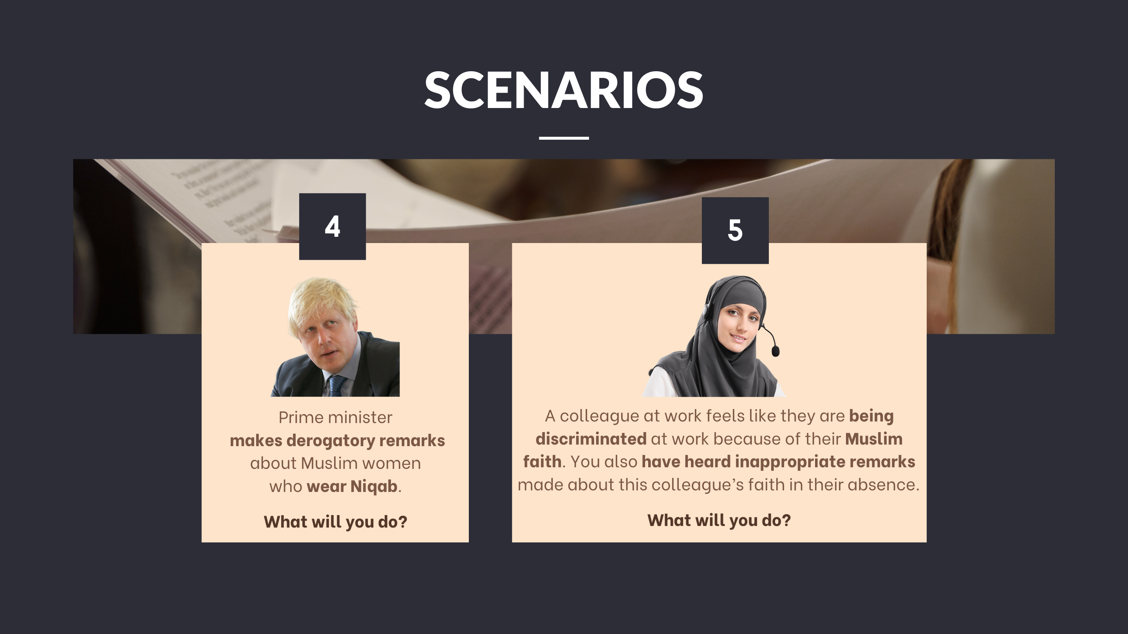

Slide 10
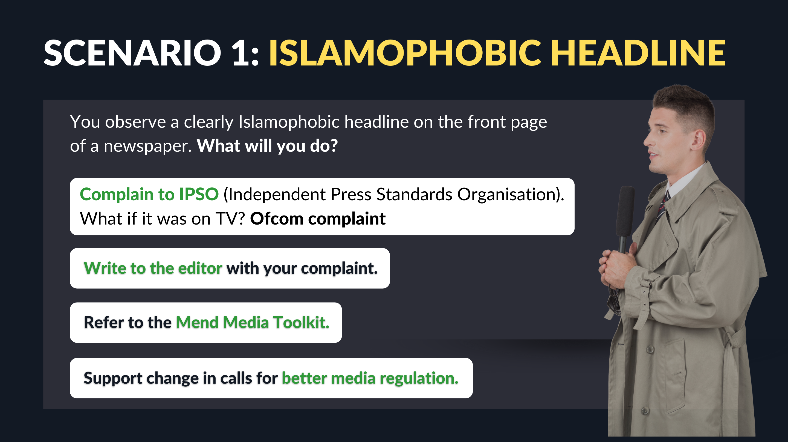

Slide 11
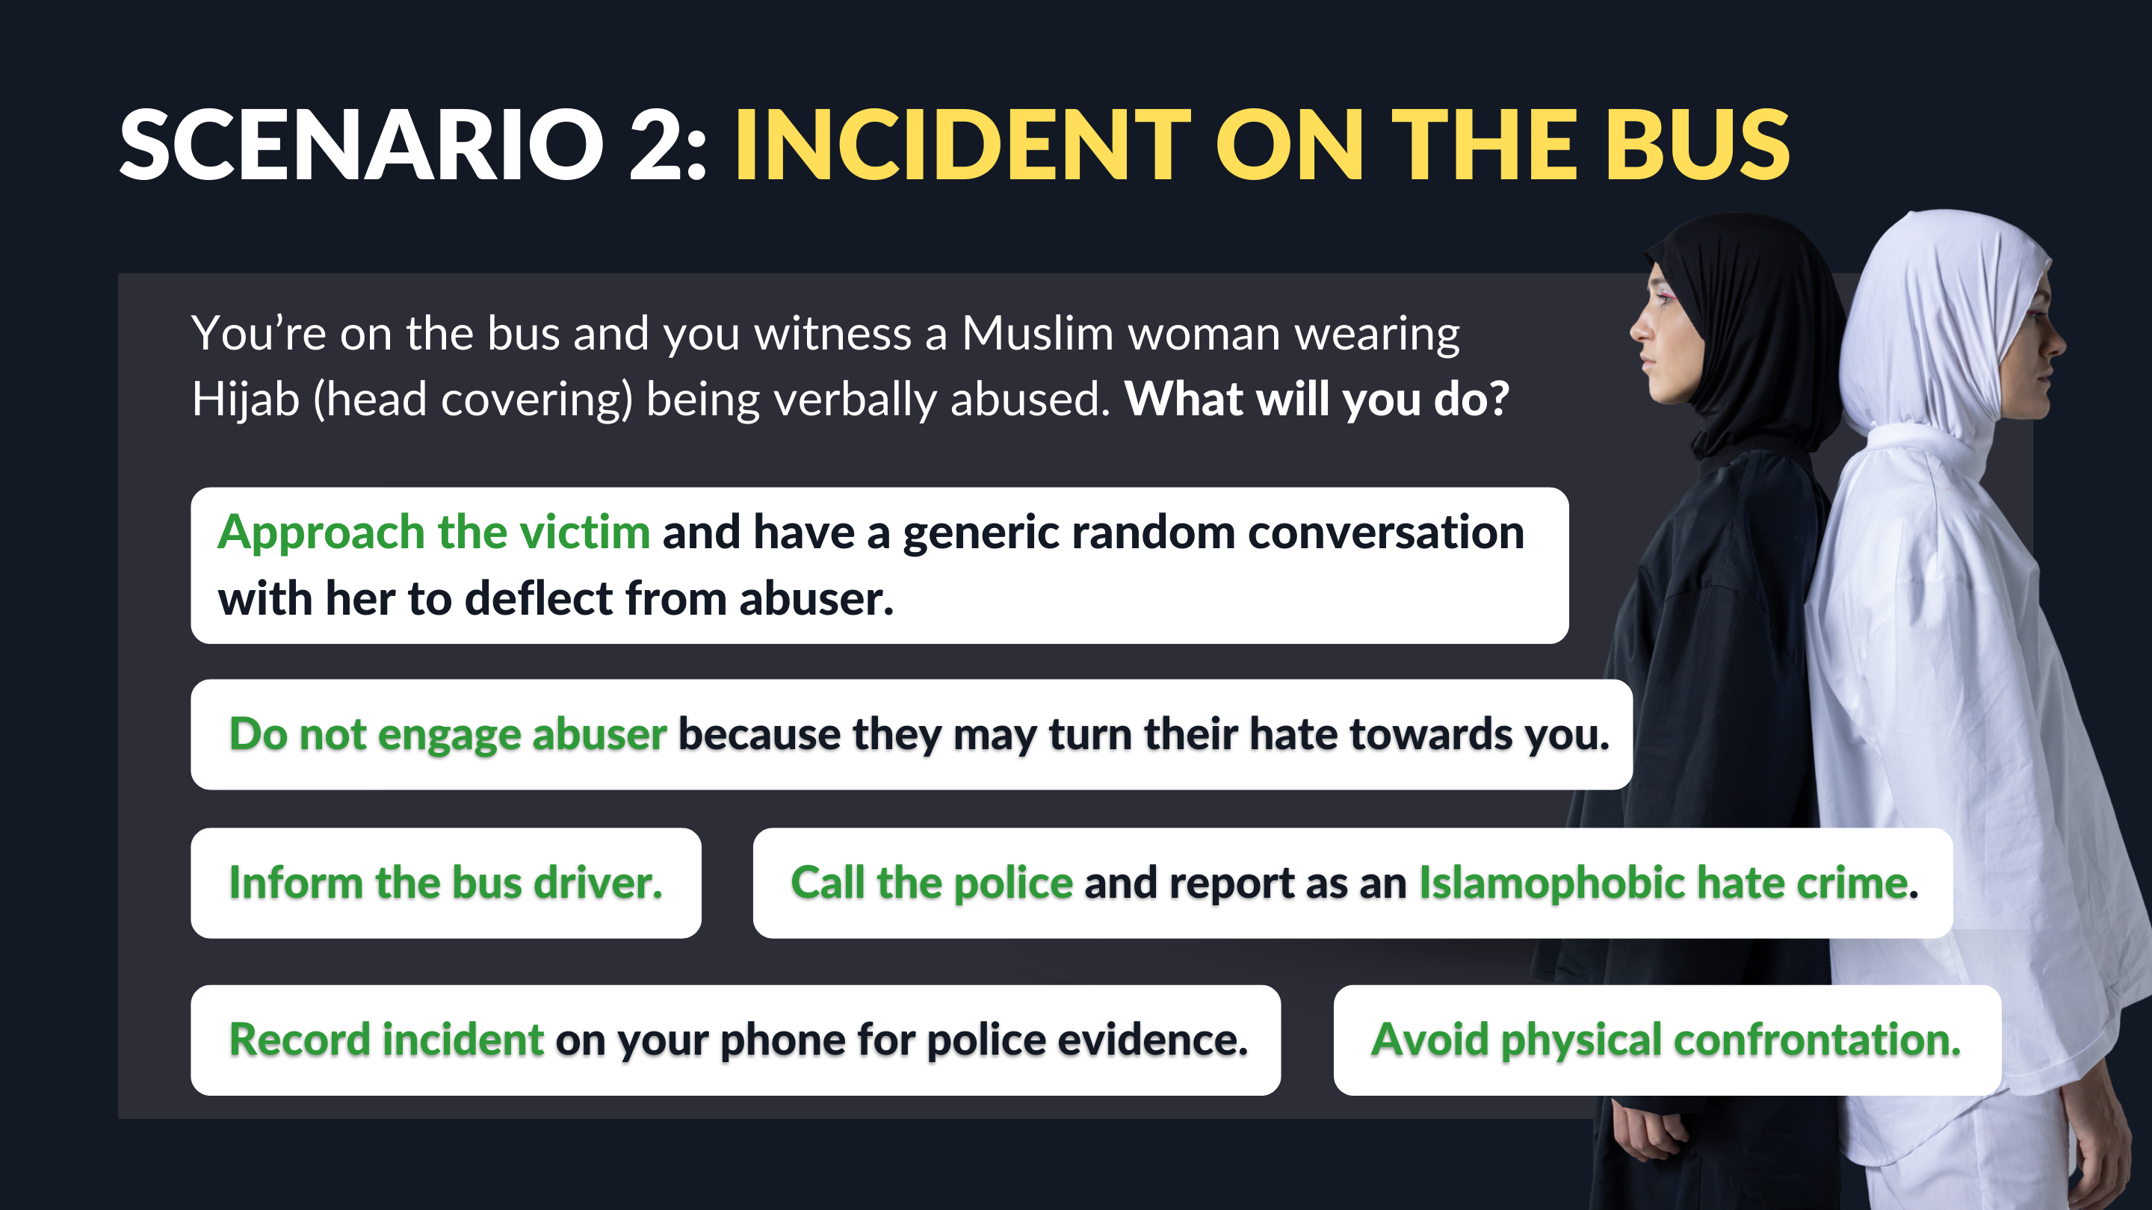
Scenario 2: Incident on the Bus
You’re on the bus and you witness a Muslim woman wearing Hijab (head covering) being verbally abused. What will you do?
Approach the victim and have a generic random conversation with her to deflect from abuser.
Do not engage abuser because they may turn their hate towards you.
Inform the bus driver.
Call the police and report as an Islamophobic hate crime.
Record incident on your phone for police evidence.
Avoid physical confrontation.

Slide 12
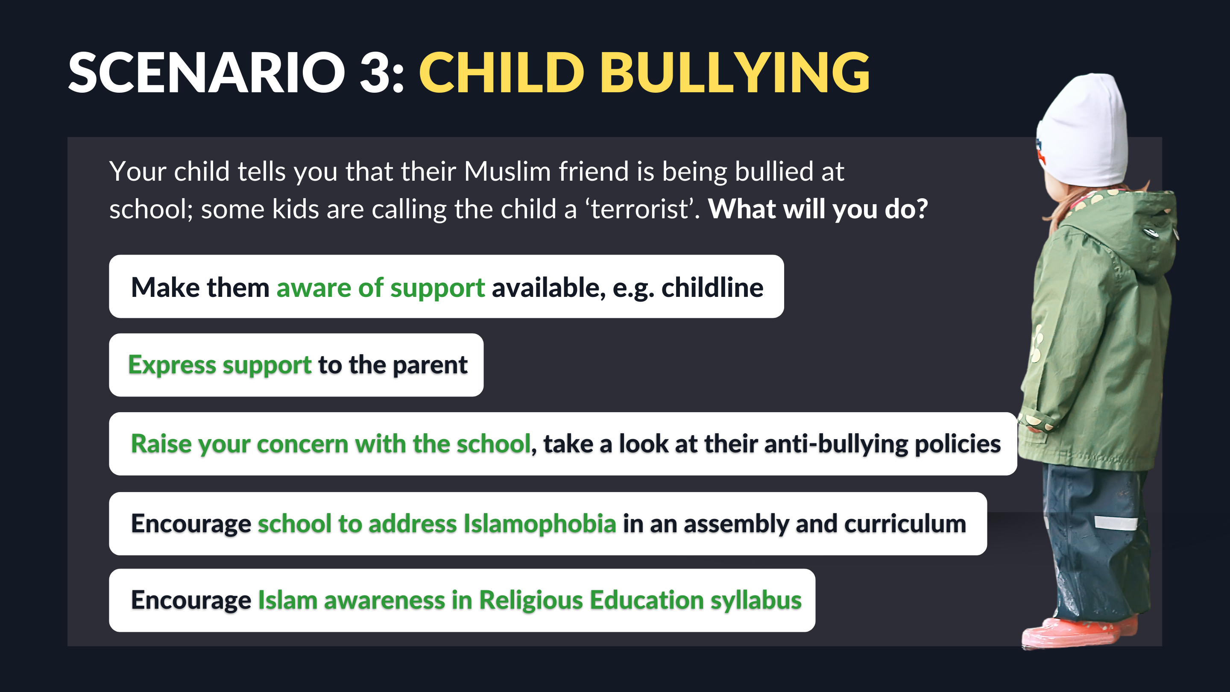
Scenario 3: Child Bullying
Your child tells you that their Muslim friend is being bullied at school; some kids are calling the child a ‘terrorist’. What will you do?
Make them aware of support available, e.g. childline
Express support to the parent
Raise your concern with the school, take a look at their anti-bullying policies
Encourage school to address Islamophobia in an assembly and curriculum
Encourage Islam awareness in Religious Education syllabus

Slide 13
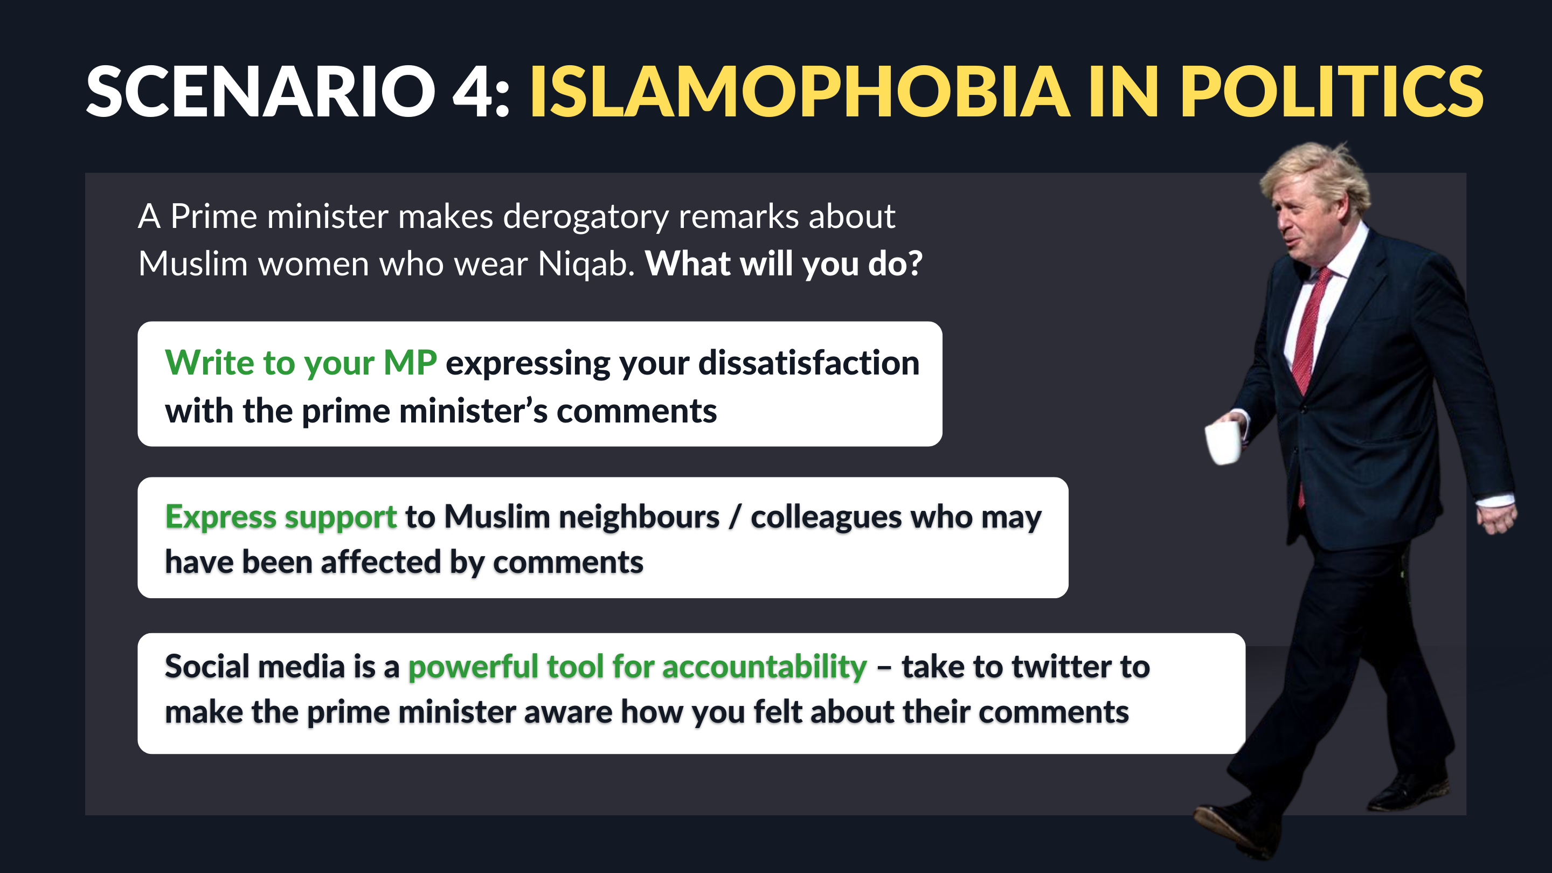
Scenario 4: Islamophobia in Politics
A Prime minister makes derogatory remarks about Muslim women who wear Niqab. What will you do?
Write to your MP expressing your dissatisfaction with the prime minister’s comments
Express support to Muslim neighbours / colleagues who may have been affected by comments
Social media is a powerful tool for accountability – take to twitter to make the prime minister aware how you felt about their comments

Slide 14
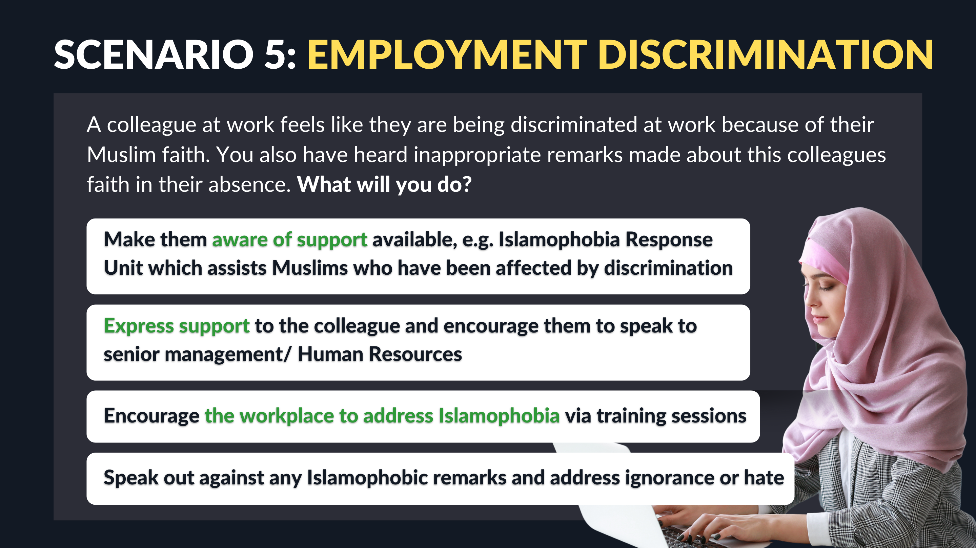
Scenario 5: Employment discrimination
A colleague at work feels like they are being discriminated at work because of their Muslim faith. You also have heard inappropriate remarks made about this colleagues faith in their absence. What will you do?
Make them aware of support available, e.g. Islamophobia Response Unit which assists Muslims who have been affected by discrimination
Express support to the colleague and encourage them to speak to senior management/ Human Resources
Encourage the workplace to address Islamophobia via training sessions
Speak out against any Islamophobic remarks and address ignorance or hate

Slide 15

What to do if you face Islamophobia?
Tell any member of staff
Report to Police
  999 (Emergency)
  101 (Non-emergency)
Contact Childline (0800 1111)
Report to Islamophobia response unit (IRU) www.theiru.org.uk
Visit www.stophateuk.org/talk-to-us

