Slide 1
#AdoptTheDefinition
Understanding Islamophobia and Why we need a definition
Notes:
Aim; Highlight how Islamophobia can manifest outside of physical or verbal abuse and why we need a definition to effectively tackle it, by going beyond current hate crime legislation.
Outcome; Have a better understanding how Islamophobia is a form of racism, have a better understanding and appreciation for the definition we have and why it is important.
Duration: to cover this presentation in 30min including Q&A or discussions.

Slide 2
Notes:
Purpose: Stats can be used when we speak about the issue. Reality of the situation. Paints a picture of why we actually need to pay more attention to Islamophobia amongst other prominent forms of racism.
Presenter note: put the figure into context i.e.
It is recent and plucked from the Home Office report.
Muslims only make up just under 5% of the population (Census) and yet are the most targeted religious group – disproportionate – makes us think why?
Scotland – CPG public inquiry 2021 revealed 75% respondents felt Islamophobia was not only an everyday issue but getting worse. So this statistic alongside other evidence just emphasises the pervasiveness of Islamophobia.
Ultimately, this statistic may not even account for the number of instances that go unreported due to various reasons (e.g. frequent Islamophobic incidents become normalised and people do not want to bother the police with paperwork or report it when there is no solution)

Slide 3
Why is it important to have a definition?
We can only tackle Islamophobia effectively if we define what it means and entails.
The first step in identifying the problem and in turn, addressing it.
”No amount of documentation of the evidence of discriminatory outcomes faced by Muslims... can satisfy our desire to reverse these results if we cannot begin from the point of an agreed definition.” (APPG Report, p. 26)
A means of recognising the hardships faced by the British Muslim community.
The definition enjoys support among Muslims of varying backgrounds – 750+ Muslim organisations have endorsed it. It has been devised following a year of consultation with data from 100s of Muslim organisations and constituents nationwide.
Accompanying current hate crime legislation as an effective policy tool
It goes beyond hate crime legislation, which only covers physical or verbal assault. It shows all the manifestations of Islamophobia, for instance in the workplace, in youth activism in schools, employment processes etc.
Notes:
Presenter notes:
We can use just some (of these) reasons as to why a definition, something so simple can actually be a powerful policy tool and this can also be emphasised by the current widely accepted definition.
The widespread acceptance of the definition - It shows that the community are unified on their understanding of Islamophobia as victims.

Slide 4
What is the Definition of Islamophobia?
“Islamophobia is rooted in racism and is a type of racism that targets expressions of Muslimness or perceived Muslimness.”
APPG on British Muslims 2018 Report, Islamophobia Defined
Notes:
Emphasise on key words when reading out i.e. racism and Muslimness.
Presenter notes:
Maybe pose the question as to what their initial thoughts or observations are of this definition (not whether they agree with it or not)

Slide 5
How is Islamophobia a “type of racism”?
Muslims are victims of more than overt expressions of religious hatred and abuse.
Islamophobia is a system of discrimination, control and socio-economic exclusion.
Permeates the media, the labour market, education, politics, policing, etc. – in this way, Islamophobia manifests itself as a form of racism.
“Rooted in racism” – Muslims are not a race, but they are racialised.
Muslims are homogenised based on certain cultural and ethnic markers, i.e. “expressions of Muslimness”.
The term “Muslimness” “describes a family of overlapping and flexible features by which in a given situation something is seen as having the quality of being Muslim.” Professor Salman Sayyid & AbdoolKarim Vakil
Notes:
Purpose
To break down the conceptual elements of the definition
To begin using the terms interchangeably
It goes beyond hate crime legislation, which only covers physical or verbal assault. It shows all the manifestations of Islamophobia, for instance in the workplace, in youth activism in schools, employment processes etc. Removes any blurs and crossovers with typical racism or biases.
Presenter notes:
Can give further examples of how racism and Islamophobia manifest under the areas mentioned i.e. media (negative perspectives), labour market (issue with equal opportunities and accessibility to the labour market)
Racialisation can be seen through the association of Muslims with an Arab who in reality may be Christian for instance.
Rooted in religion vs rooted debate:
Racism in all its forms is not a contemporary issue but a long sustained issue. Many forms of discrimination targeting ethnic or religious groups have stemmed from this sentiment.
When there is an issue or ‘hatred’ for a religion it can be exercised through academic debate or expressing discontent with overt religious practices but the various manifestations of racism and Islamophobia is not out of fear of the religion becoming dominant but certain groups that don’t conform to British norms not necessarily due to religion but other ethnic markers as well.

Slide 6
What are some “expressions of Muslimness”?
“Muslim-sounding names” such as Mohammed
Items of clothing such as the Hijab/Abaya/Niqab (for women) and the thawb/ taaqiyah (for men)
Physical characteristics such as a beard
Speaking in a foreign language such as Arabic
Behavioural traits such as prayer and recitation of the Holy Qur’an
Notes:
Purpose:
Not to expose prejudices but to show us what common stereotypes have been used to target specific groups in harmful ways.
To make us all think (Muslims and non Muslim alike) what stereotypes we have and why? What influences them? For Muslims why do we consider the following traits to represent ‘visibly Muslim’ people when there is a huge diversity within the faith? (media, Muslims in public spheres)
Presenter notes:
Note: we are not talking about just physical characteristics here but behaviours
Ask the audience– what do they think visually when we say Muslim or an expression of Muslimness?
Spend about 5 minutes discussing this and be open to suggestions.

Slide 7
Notes:
Sources from the BBC and Independent
Purpose:
To highlight the various levels Islamophobia is in society and notably targeting those who exhibit perceived Muslimness or expression of Muslimness. Notably, these have happened in the workplace.
Presenter notes:
There is a wealth of documented instances of parliamentarians from across the political spectrum who have experienced some type of abuse not only in their careers but in their youth. Either because they have a Muslim sounding name, speak a foreign language or are not of a white ethnic background.
This example also includes Islamophobia’s manifestations in institutions and the workplace so casually

Slide 8
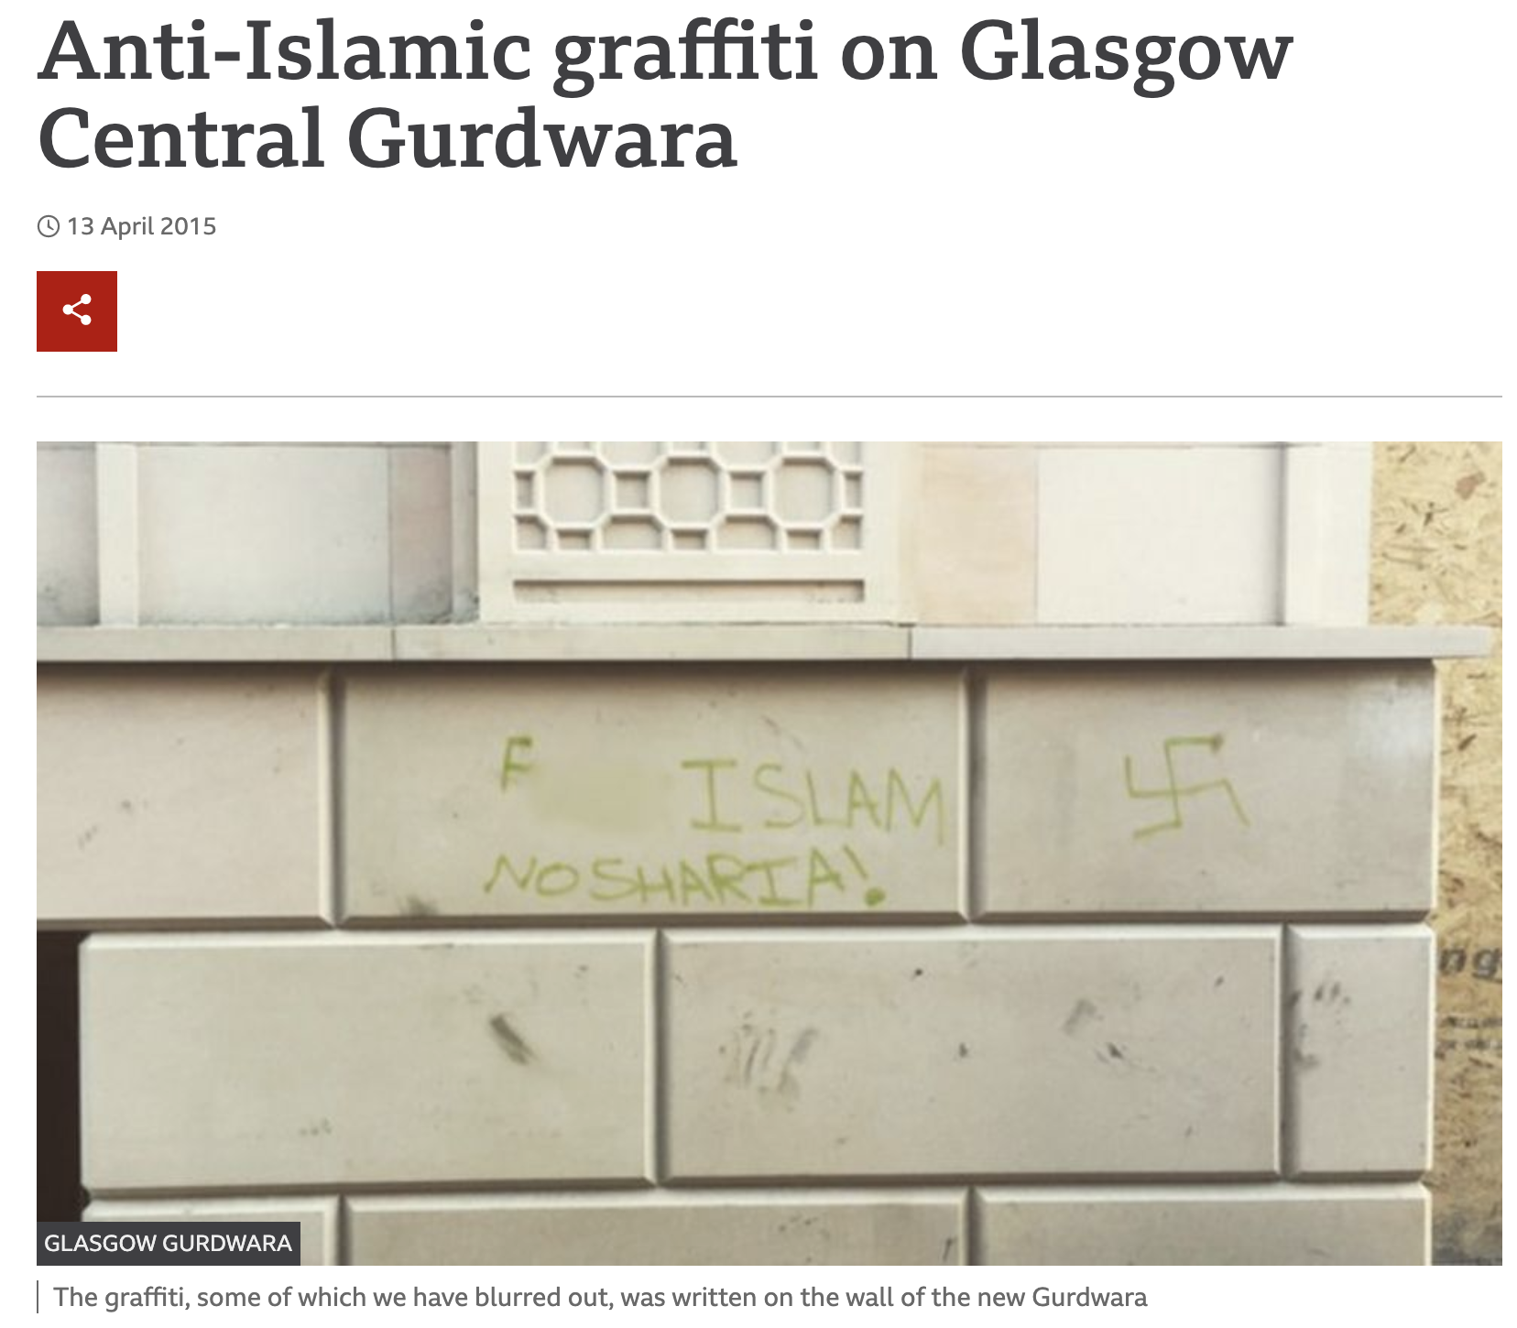
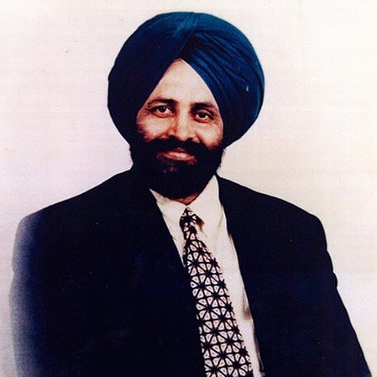
What about “perceived Muslimness”?
Notes:
Purpose:
Explain the difference between expression and perceived Muslimness, namely that perceived highlights that Islamophobia is a better term because the issue affects non Muslims too. (Hence, we do not encourage using the term anti-Muslim hatred)
Highlighting examples such as this is key to demonstrate that Islamophobia, if understood as a form of racism affects more than those who are Muslims but other BME and minority communities – this is the devastating impact of Islamophobia and how embedded it is in British society.
Presenter notes:
Sukhwinder Sodhi is the man on the left. He is from the U.S. and post 9/11 was murdered because he was perceived to be Muslim. Again how can Islamophobia be a hate for the religion when people do not know about it. A turban is a traditional religious headwear for Sikh men and not Muslim men/women.
Associating temple goers in Muslim areas as Muslim, and those who spend time with Muslim neighbours or friends. Associating the appearance of mosques and Gurdwaras as the same place of worship simply because they do not look like a church or something foreign.

Slide 9
But is the definition enough?
No BUT, the conceptualisation of Islamophobia as racism is useful and having a wide/short definition is better than having a narrow/long one.
However, guidelines are necessary to show how the definition should be applied in practice.
MEND advocates that the APPG definition should be applied in conjunction with the guidelines put forward by the Coalition Against Islamophobia.
The CAI guidelines include various of Islamophobia (non-exhaustive).
Notes:
Purpose
To appreciate that we have a short, easily understood definition and appreciate that we are able to explain it to others as a starting point on a complex issue.
To highlight that the definition is a meaningful concept but needs further guidelines to help policymakers and policy enforcers apply the definition in practice by knowing what behaviour is Islamophobic in everyday life.
Presenter notes:
Why Islamophobia falls within a racism and having a wide/short definition is better than a narrow/long one
Is it a better definition than others? Should we stop arguing and just work with what we have?
Why are guidelines important? → policy-applicable

Slide 10
Example Guidelines
Making mendacious, dehumanising, vilifying, demonising, or stereotypical allegations about Muslims.
Charging Muslims with conspiring to harm humanity and/or the Western way of life or blaming Muslims for the economic and social ills of society.
Accusing Muslims as a collective of being responsible for real or imagined wrongdoing committed by a single Muslim person, group or nation, or even for acts committed by non-Muslims.
While criticism of Islam within legitimate realms of debate and free speech is not in itself Islamophobic, it may become Islamophobic if the arguments presented are used to justify or encourage vilification, stereotyping, dehumanization, demonization or exclusion of Muslims. For example, by using criticism of religion to argue that Muslims are collectively evil or violent.
Applying double standards by requiring of Muslims a behaviour not expected or demanded of any other social, religious or ethnic group.
Objectifying and generalising Muslims as different, exotic or underdeveloped, or implying that they are outside of, distinct from, or incompatible with British society and identity.
Notes:
Purpose
Highlight how some behaviours/actions are not only common but can be particularly harmful and need to be held accountable.
Presenter notes
Give examples for each guideline.
Examples can include but are not limited to the following:
B) blaming predominantly Muslim areas or just minority of Muslims in an area for flytipping/littering, trafficking and crime. Even though these issues are not exclusive to Muslims/BME groups and holding them to double standards
C) Preaching Muslims are terrorists or terrorist sympathisers for not condemning terrorists or every instance where a perceived Muslim has committed a wrongdoing in society
D) There is nothing academic or intellectual in debate about throwing bacon into a mosque or attacking a visibly Muslim woman and her children

Slide 11
“A definition is not a magic spell. Defining Islamophobia will not by itself end Islamophobia. What is needed is not a detailed legal definition but one capable of circulating in broader society, and changing the way in which Islamophobia is understood and resisted. This means a definition that is brief, which builds on already existing norms of public etiquette and which triggers a debate that helps to change the national conversation.”
Professor Salman Sayyid & AbdoolKarim Vakil
Notes:
Purpose
To provide a nice summary of what we want everyone to take away from this presentation, namely…
Presenter notes
That the definition is not a means to an end, its has no legal repurcission per se but
Is a short, easy to understand definition that can start a conversation on a difficult issue and
Changes our current and anaemic understanding of Islamophobia, that being physical/verbal abuse (visible vs. invisible abuse)

Slide 12
What is the endgame?
Adopting a formal definition of Islamophobia is just the first step – a means to devise a comprehensive strategy to tackle it.
Councils using the definition as a basis for further work to tackle Islamophobia.
E.g. an equalities framework incorporating Islamophobia/other racisms and raising awareness (IAM partner).
Working with other local institutions and bodies to eradicate Islamophobia, i.e. schools, colleges, public transport companies, employers, etc.
The Government (Westminster & Scotland) adopting the definition.
Robust strategy to tackle Islamophobia (legislative changes, reforming counter-terror policy, better media regulation, etc.)
Accountability and changing perceptions – opening the conversation can will hopefully change harmful perceptions about Muslims that organisations, lobbies or media currently present.
Notes:
Where and who would this impact:
The work of the council – what do we anticipate?
The local Muslim community
Wider Diversity & Inclusion practices in workplaces
In the long run for instance for:
Not just the councils but government
Police as they would not have issues with reporting between race or religiously aggravated hate crimes
What do you want to see councils/orgs do?

