Slide 1
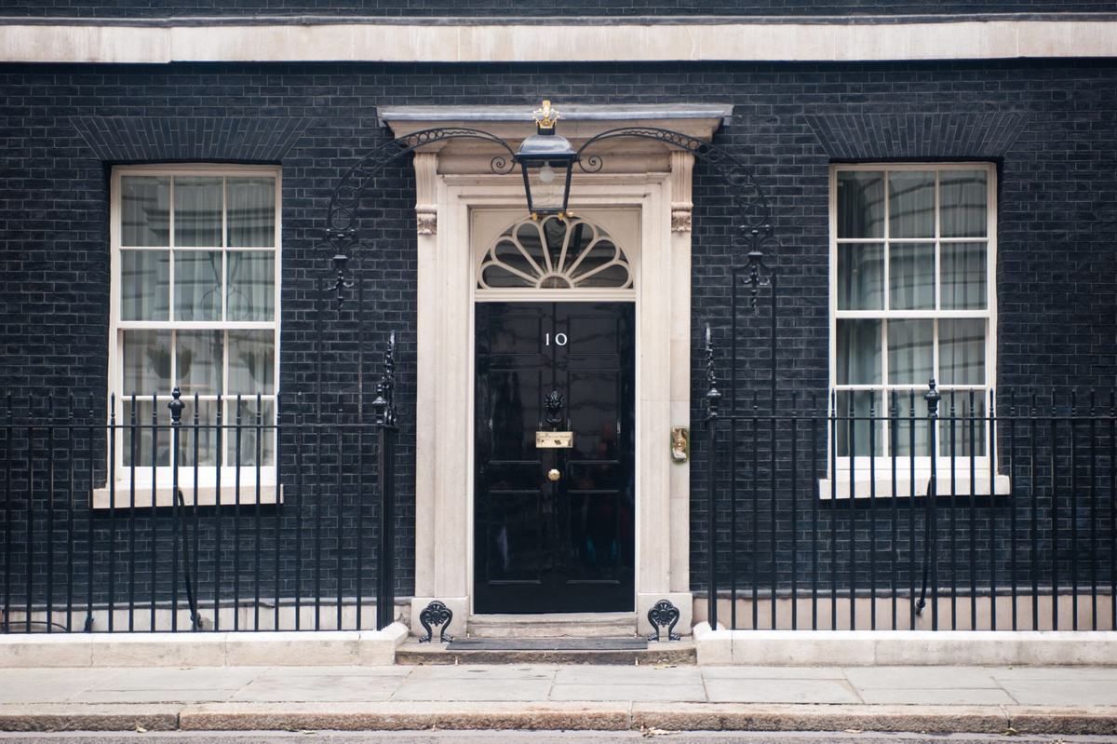
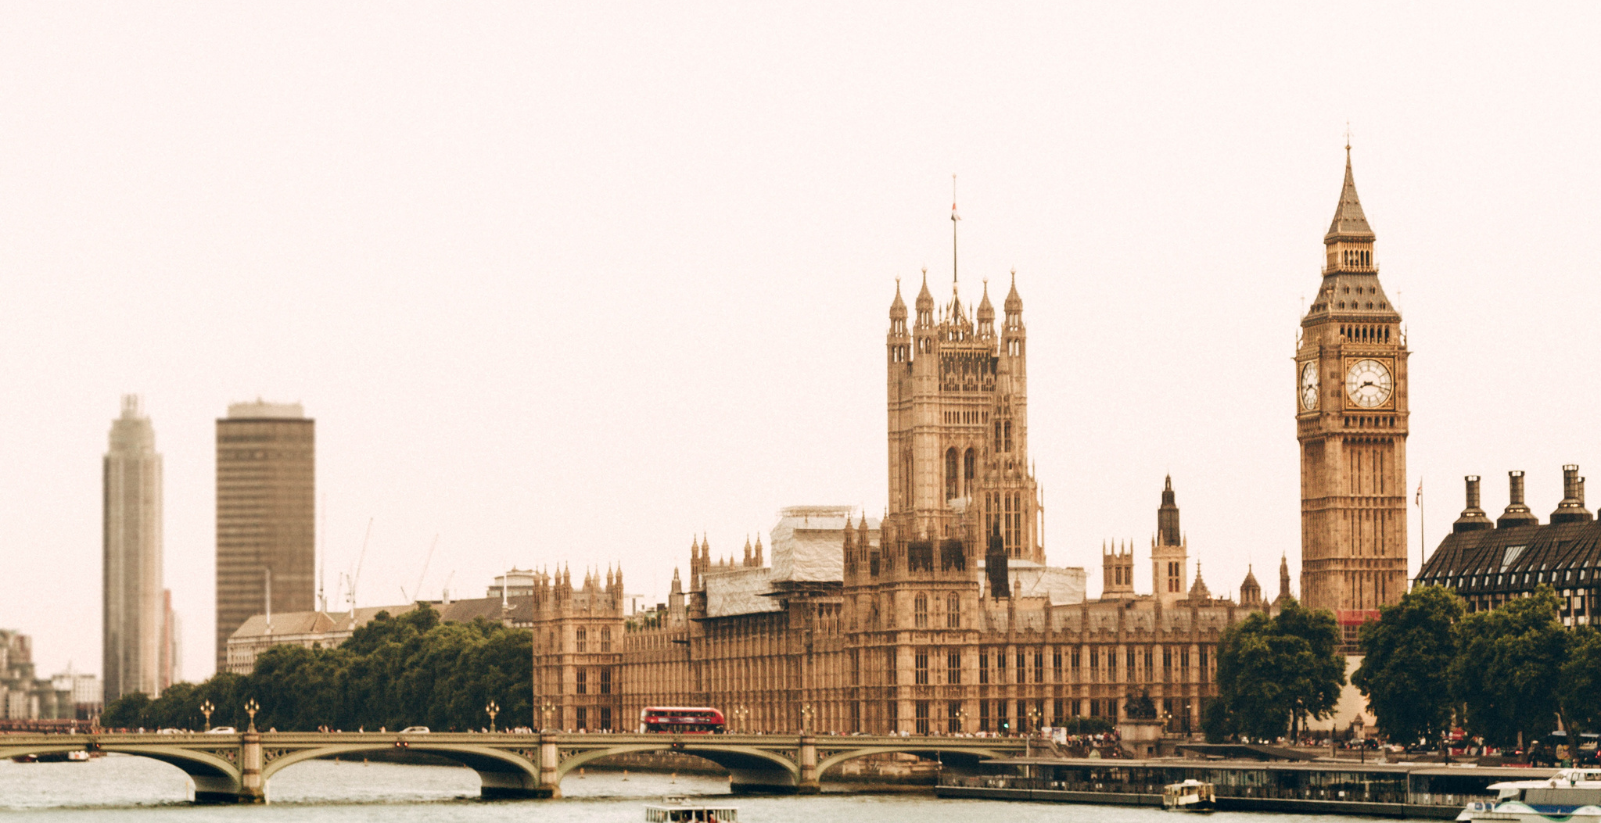

The British Executive, Legislative, and Judicial Branches of Government
01
MEND POLITICS MASTERCLASS 2021
Notes:
Min Title Page

Slide 2
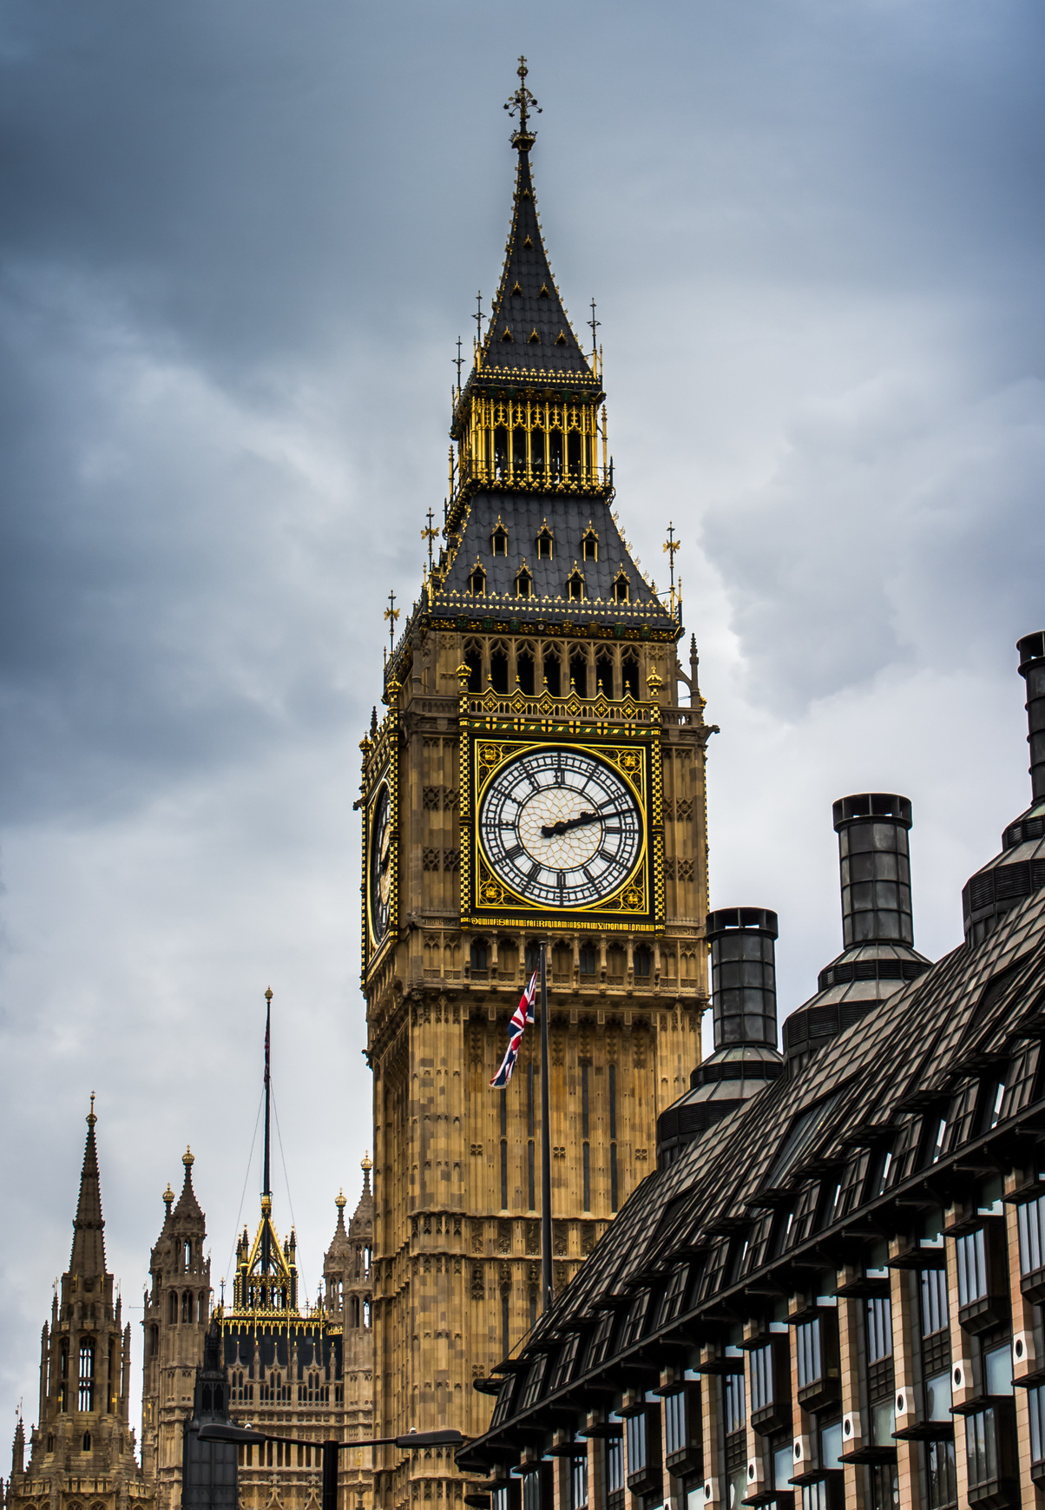
Overview
  The executive and the legislative branches
  Local government
  Devolved powers
  How laws are made
  Voicing opposition to laws
  The judicial system
Notes:
Contents Page

Slide 3
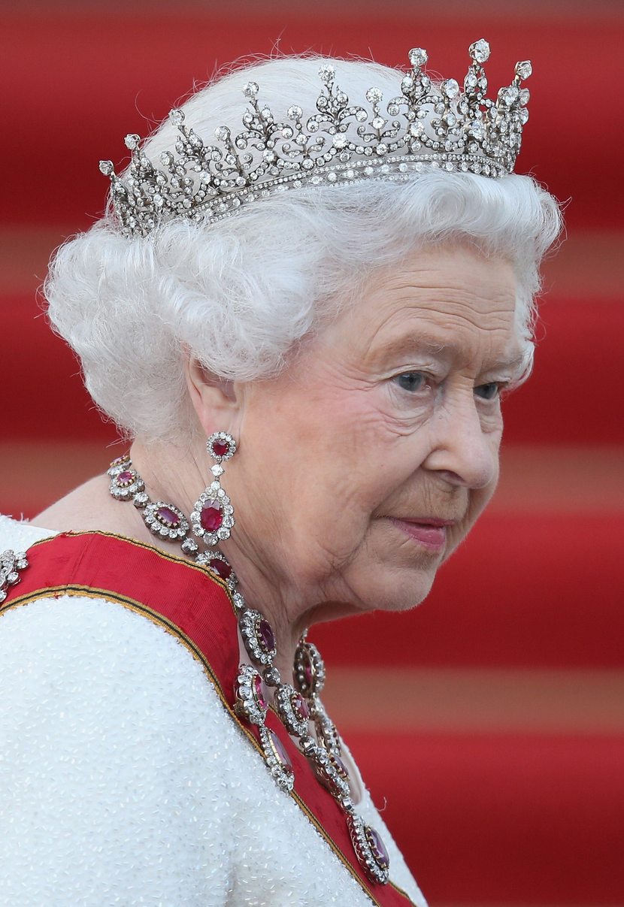
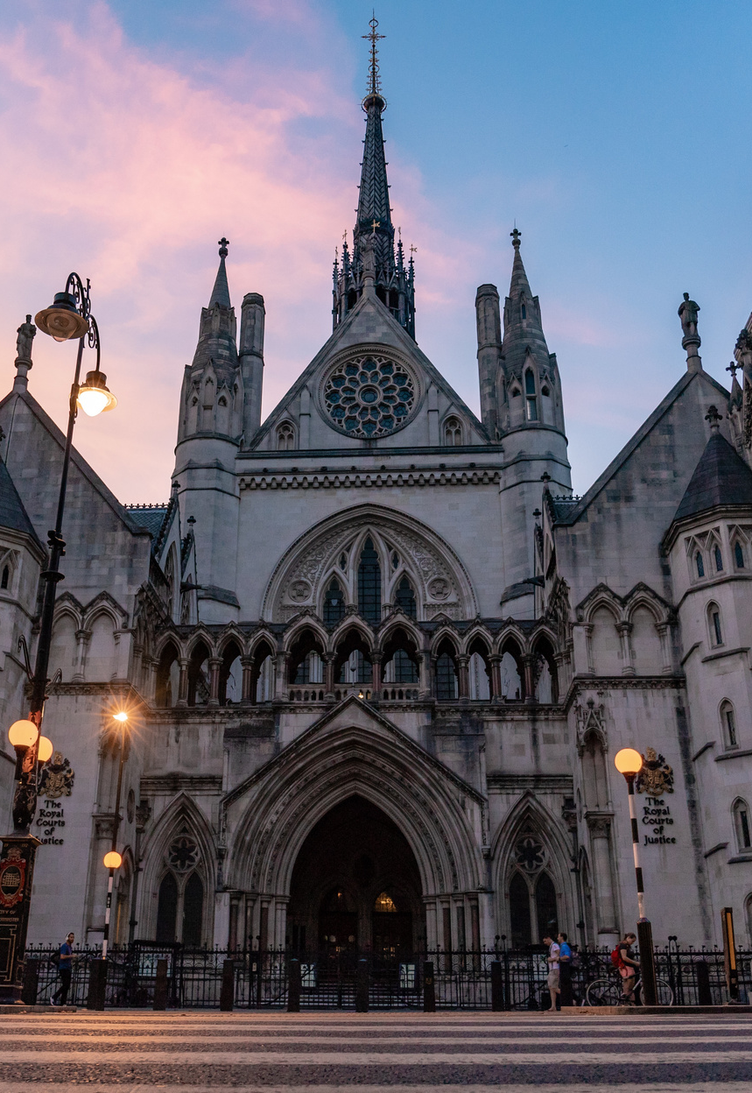
The Branches of Government

Slide 4
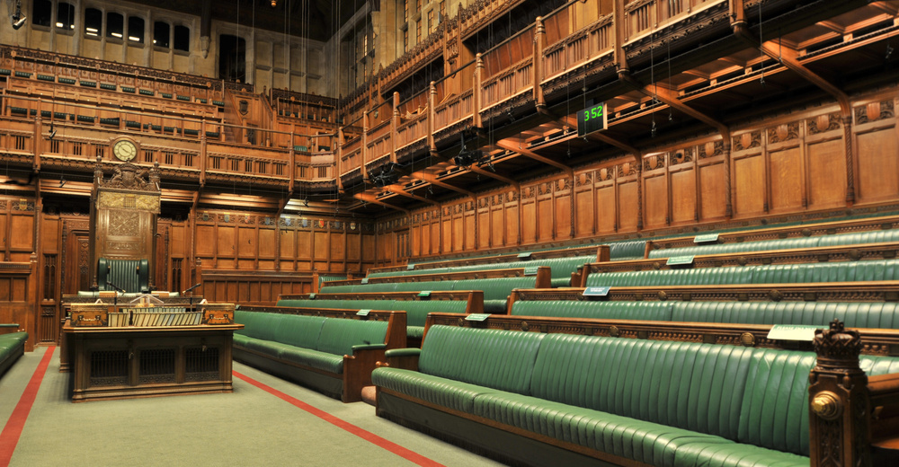
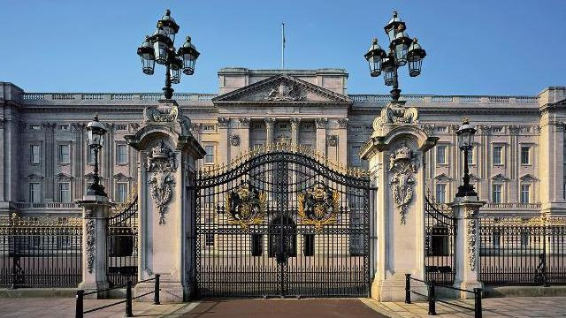
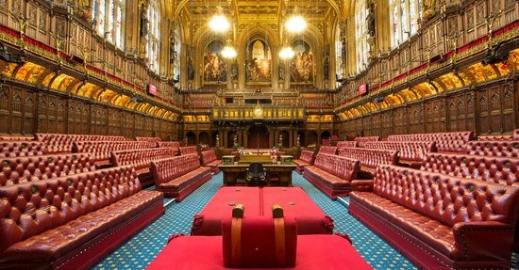
Parliament: The Legislative Branch
House of Commons
The Monarch
House of Lords

Slide 5
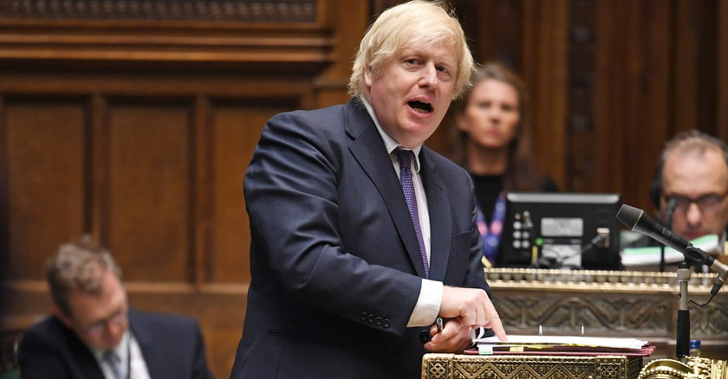
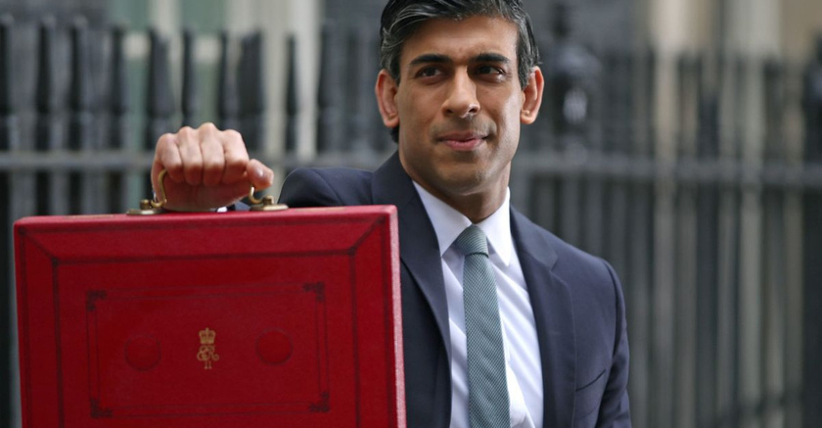
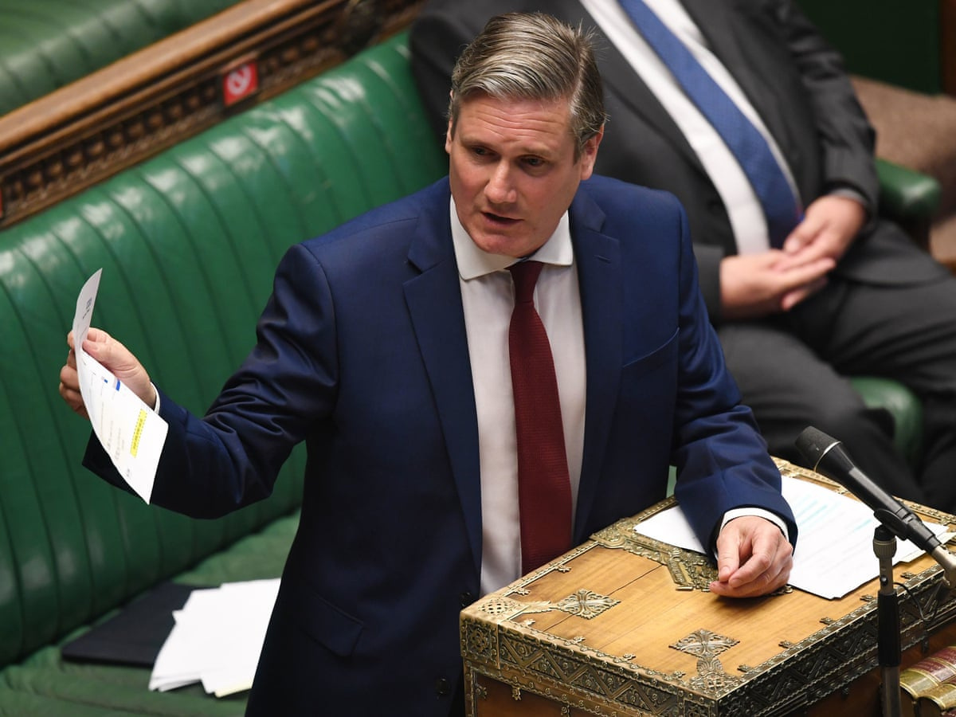
Government: The Executive Branch
The Prime Minister
The Cabinet
The Shadow Cabinet

Slide 6
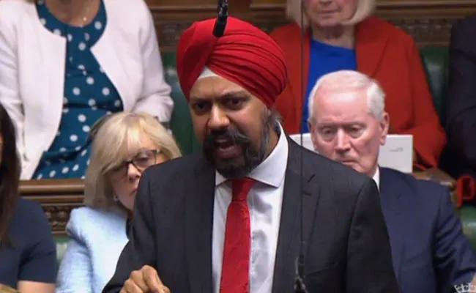
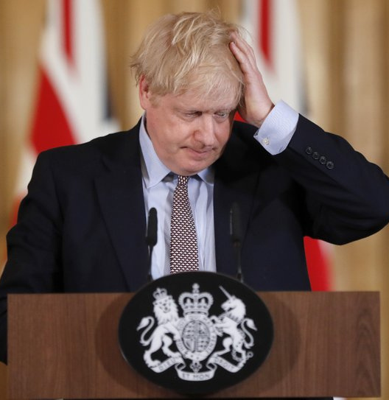
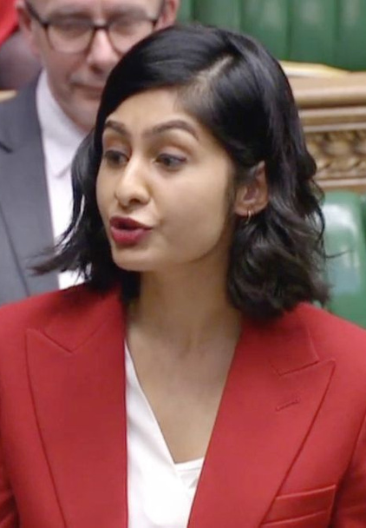
What Holds The Government To Account
  Parliamentary Questions
  PMQs / FMQs
  Committees
  Royal Prerogative
  Judicial Review
  The Attorney General
  The Advocate General
  The Press
Notes:
Slide with Content

Slide 7
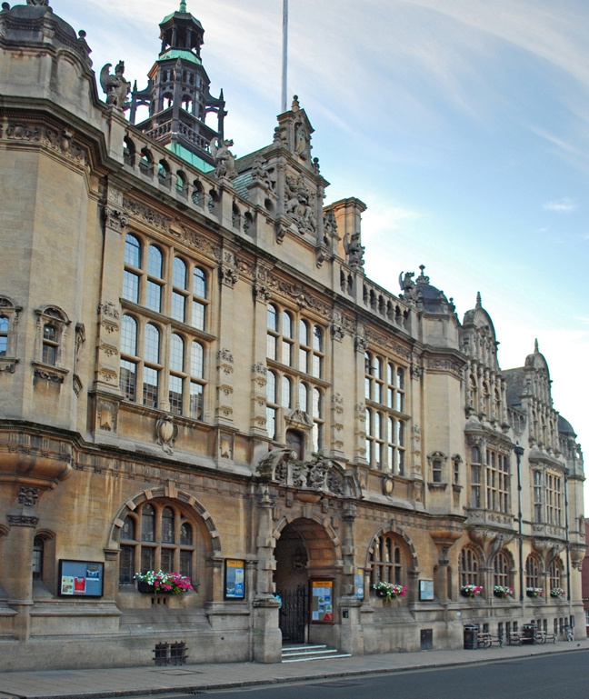
Local Government in England
Two Tier Authorities
Single Tier Authorities
County Councils
Unitary Authorities
District, Borough, or City Councils
Combined Authorities
Parish, Community, and Town Councils

Slide 8
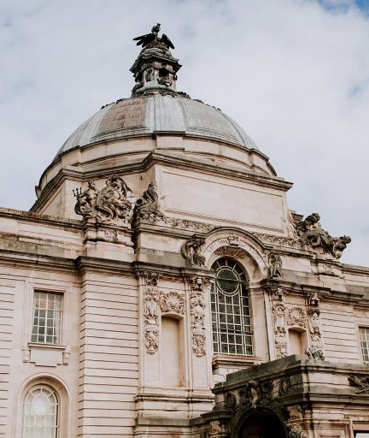
Local Government in Wales
22 unitary authorities (councils) run by councillors who are elected every 4 years
  Blaenau Gwent
  Bridgend (Pen-y-bont ar Ogwr)
  Caerphilly (Caerffili)
  Cardiff (Caerdydd)
  Carmarthenshire (Sir Gaerfyrddin)
  Ceredigion
  Conwy
  Denbighshire (Sir Ddinbych)
  Flintshire (Sir y Fflint)
  Gwynedd
  Isle of Anglesey (Ynys Môn)
  Merthyr Tydfil (Merthyr Tudful)
  Monmouthshire (Sir Fynwy)
  Neath Port Talbot (Castell-nedd Port Talbot)
  Newport (Casnewydd)
  Pembrokeshire (Sir Benfro)
  Powys
  Rhondda Cynon Taf
  Swansea (Abertawe)
  Torfaen (Tor-faen)
  Vale of Glamorgan (Bro Morgannwg)
  Wrexham (Wrecsam)

Slide 9
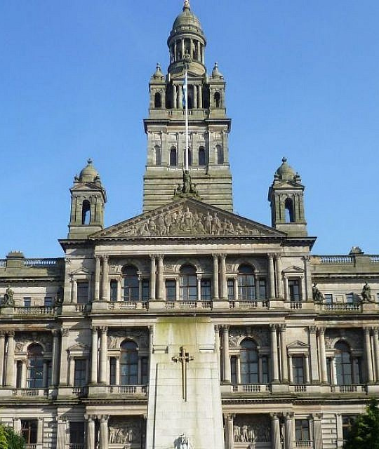
Local Government in Scotland
32 unitary authorities (councils) run by councillors who are elected every 5 years
  Inverclyde
  Renfrewshire
  West Dunbartonshire
  East Dunbartonshire
  Glasgow
  East Renfrewshire
  North Lanarkshire
  Falkirk
  West Lothian
  Edinburgh
  Midlothian
  East Lothian
  Clackmannanshire
  Fife
  Dundee
  Angus
  Aberdeenshire
  Aberdeen
  MorayHighland
  Na h-Eileanan Siar
  Argyll and Bute
  Perth and Kinross
  Stirling
  North Ayrshire
  East Ayrshire
  South Ayrshire
  Dumfries and Galloway
  South Lanarkshire
  Scottish Borders
  Orkney
  Shetland

Slide 10
What do Councillors do?
Scruitinise service delivery
Set policy on council services and spending
Sit on committees (planning, environment, children's services etc)
Develop links with other organisations to build a shared understanding of local issues that need addressing
Council
Hold drop-in surgeries
Councillor
Election canvassing
Attend local events and functions
Party
Ward
Support local organisations and campaigns
Elect local party candidates

Slide 11
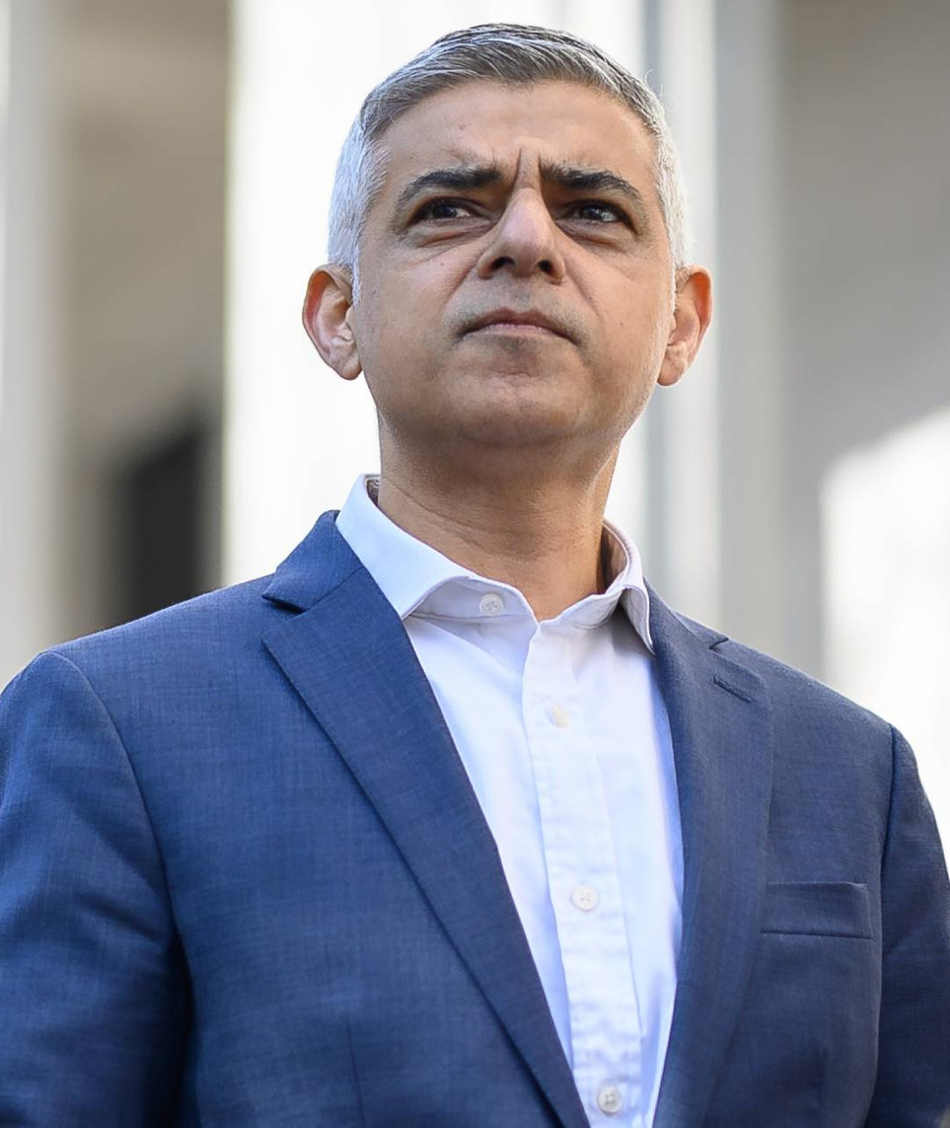
What do Mayors do?
Strategy and planning
Setting policy framework
Setting annual budget
Housing and transport

Slide 12
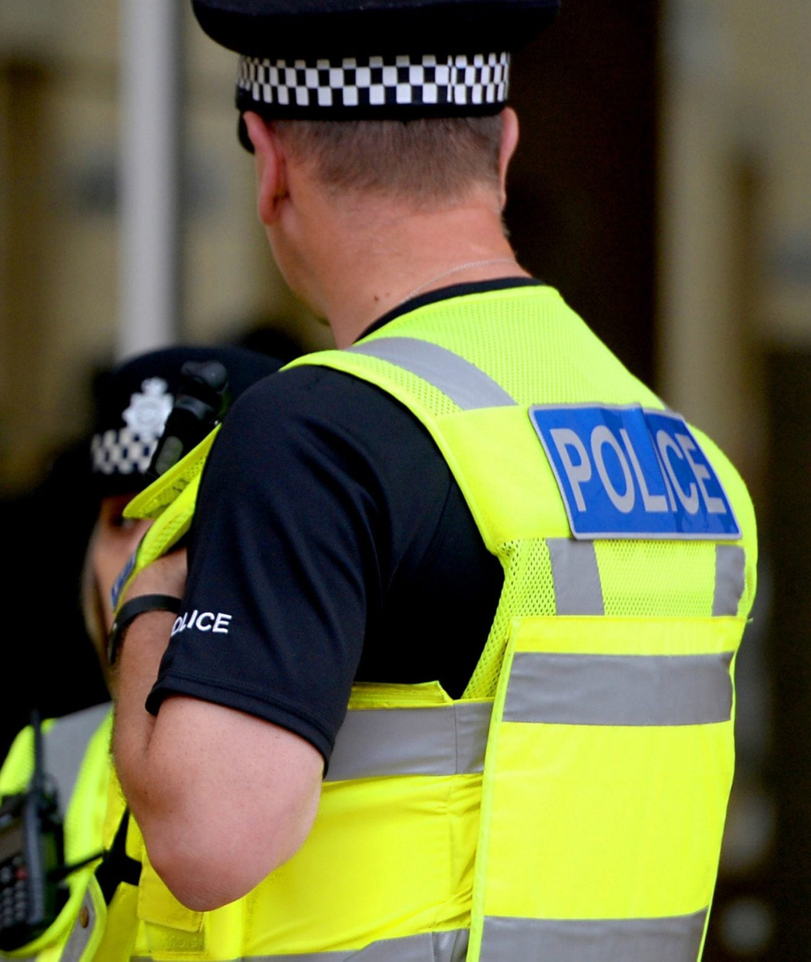
What do Police & Crime Commissioners do?
Maintain an efficient and effective police force
Hold Chief Constables to account
Overlook delivery of police and crime plan
Hold police fund

Slide 13
Devolved Powers
Devolved vs reserved powers: In the UK, there are distinct legislatures and governments in Scotland, Wales, and Northern Ireland, which all have unique powers over a range of policy areas.
UK Government
The Scottish Parliament
The Northern Irish Legislative Assembly
The Welsh Assembly
Local Government

Slide 14
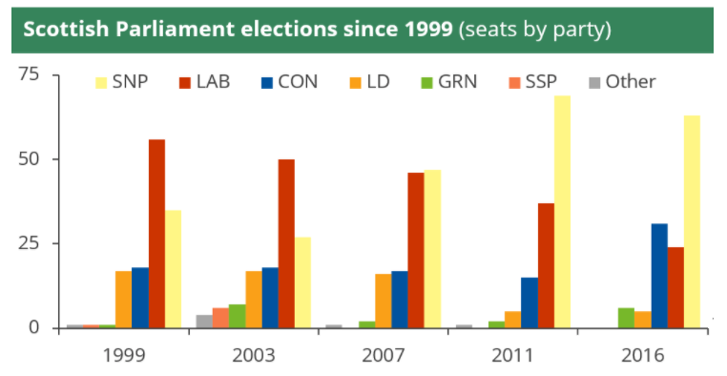
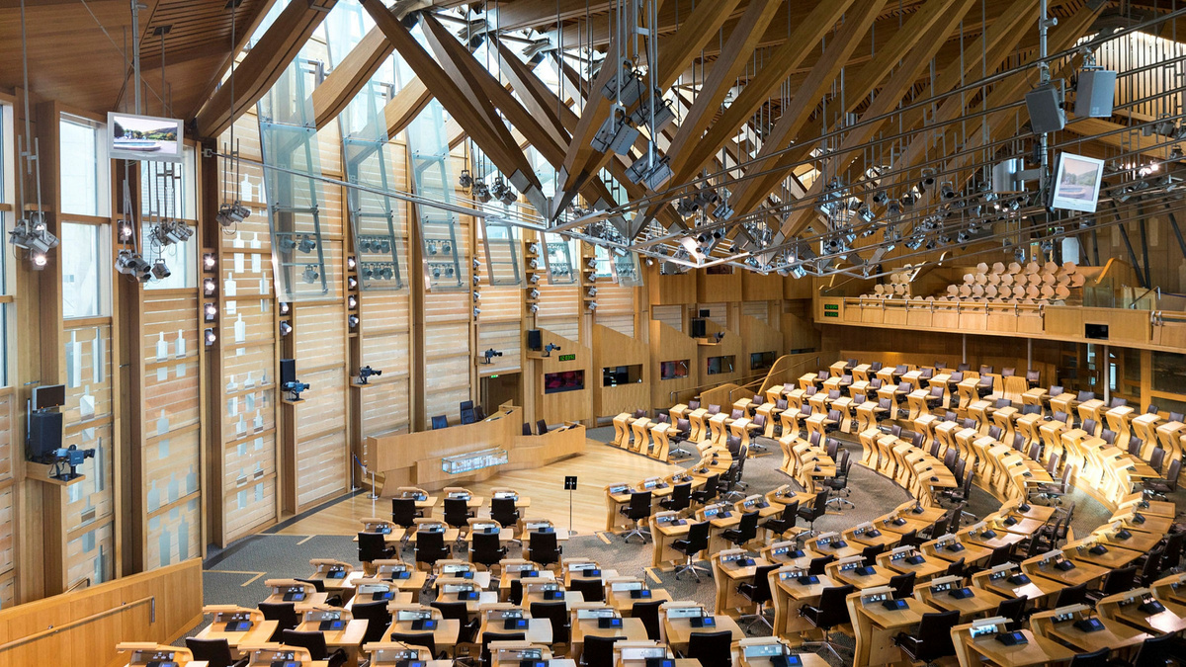
The Scottish Parliament
The Scottish Parliament creates legislation for devolved issues such as:
  Economy
  Education
  Health and social services,
  Justice
  Rural affairs (such as agriculture, forestry and fisheries)
  Housing
  Environment
  Consumer advocacy and advice
  Transport
  Taxation
  Fire services
  Law and order
  Local government
  Sports and the arts
  Tourism

Slide 15
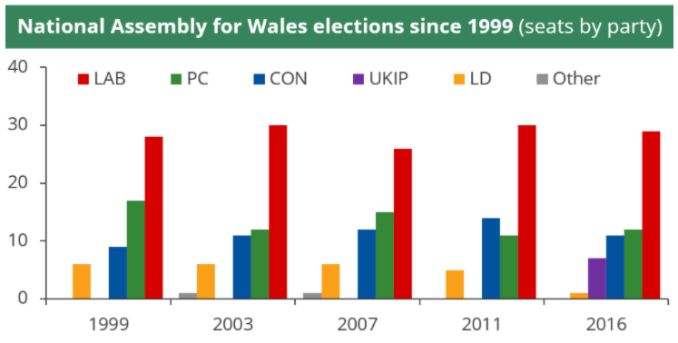
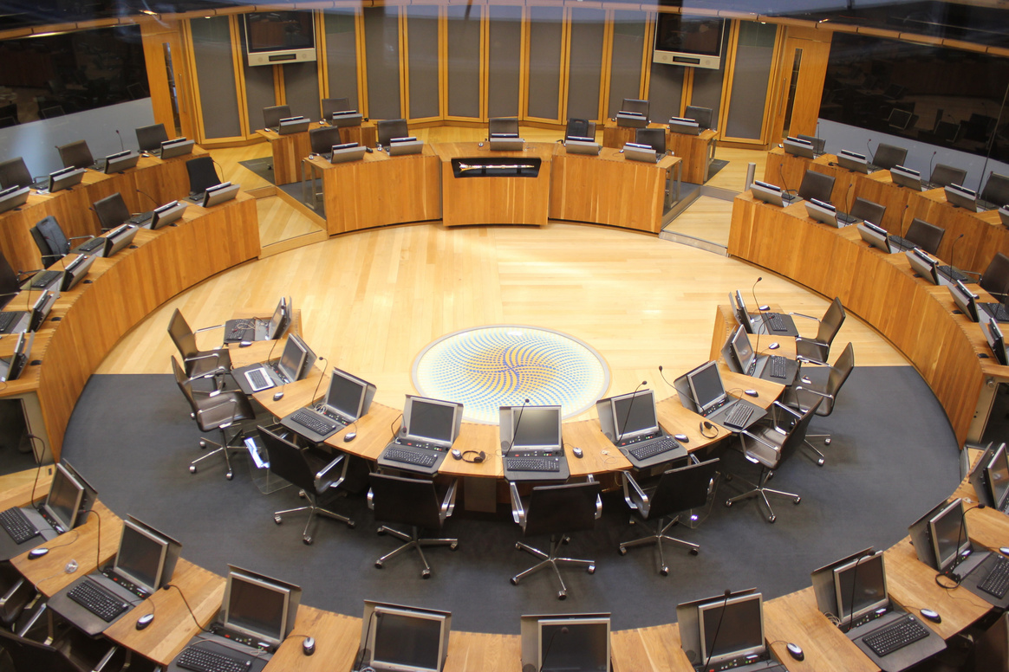
The Welsh Senedd
The Welsh Senedd creates legislation for devolved issues such as:
  Rural affairs (such as agriculture, forestry and fisheries)
  Ancient monuments and historic buildings
  Culture
  Economic development
  Education and training
  Environment
  Fire and rescue services
  Food
  Health and health services
  Highways and transport
  Housing
  Local government
  Public administration
  Social welfare
  Sport and recreation
  Tourism
  Town and country planning
  Water and flood defence
  Welsh language

Slide 16
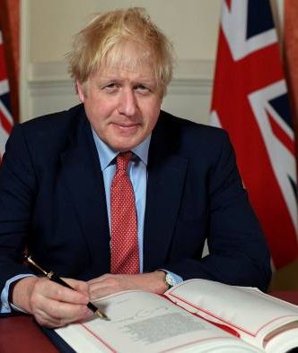
How is Legislation made?
The government's legislative agenda is defined by the ruling party's manifesto
Suggestions for new laws can also be made by individual MPs, Lords, or private individuals and organisations.
New legislation can emerge for a variety of reasons:
    Emergency issues
    Pressure to update existing laws that are now outdated.
    Clarifying established principles and gaps in existing laws or protections
    Responding to social needs arising from specific communities and groups

Slide 17
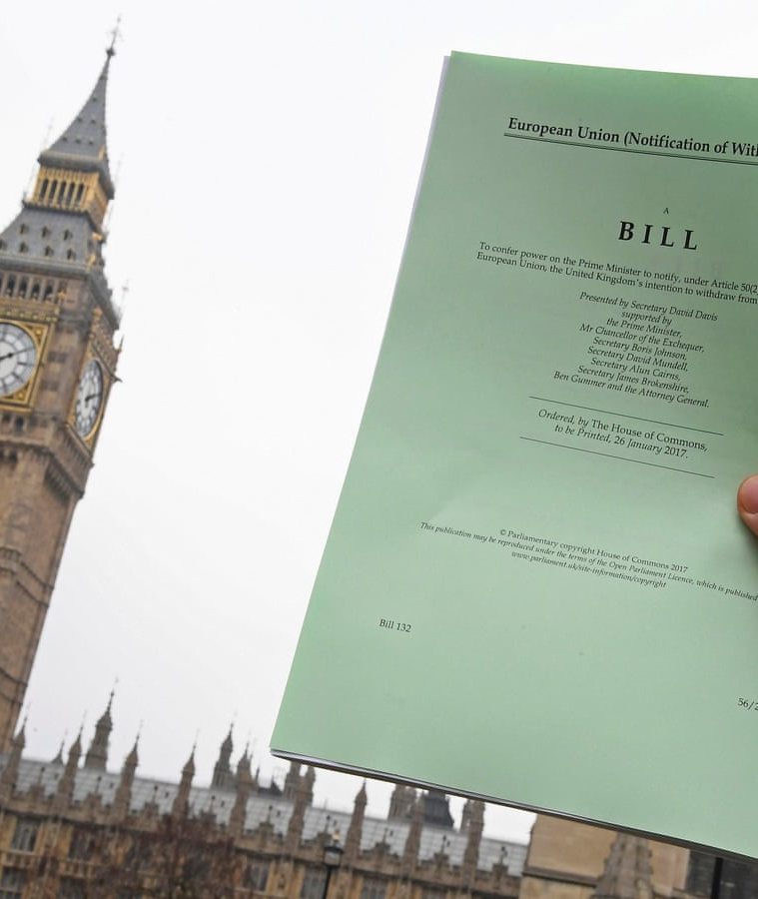
How is Legislation made?
Proposing new legislation:
  Green papers
  White papers
  Draft Bills
  Bills:
    Public Bill
    Private Bill
    Hybrid Bill

Slide 18
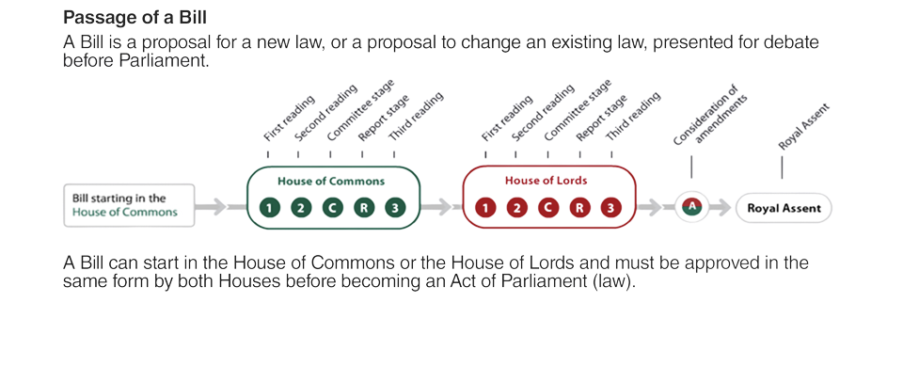
How is Legislation Made?
Notes:
Infographics Page

Slide 19
How is Legislation Made in Scotland
Stage 1
The consideration of the general principles of the bill by parliamentary committee(s).
A debate and decision on these by the Scottish Parliament.
Stage 2
A full list of suggested amendments are published.
There is a detailed consideration of the bill by parliamentary committee(s) who include necessary amendments.
Stage 3
The final consideration of the bill is held by the Parliament and a decision is made as to whether it should be passed or rejected.
Stage 4
Royal Assent

Slide 20
How is Legislation Made in Wales
Stage 1
The consideration of the general principles of a Bill by a committee (or committees).
A debate and decision on these by the Senedd.
Stage 2
There is a detailed consideration of the bill by Senedd committee(s) who include necessary amendments.
Stage 3
The final consideration of the bill is held by the Senedd and a decision is made as to whether it should be passed or rejected.
Stage 4
The Senedd votes on whether to pass the final text of the Bill.
Stage 5
Royal Assent

Slide 21
Voicing Opposition
Members of the public can voice their objections to a bill by:
  Writing to their MP/ MSP/MS or a member of the House of Lords,
  Writing to the government department responsible for the bill,
  Signing petitions,
  Submitting evidence to relevant committees or the relevant Public Bill Committee.

Slide 22
What do MPs do?
House of Commons
Sitting on Select Committees
Debates and voting on laws
Groups of MPs looking at specific issues
Hearings and reports - facts and informed opinion
Parliament
Weekly surgery
MP
Election canvassing
Attend functions, schools, meeting businesses etc.
Party
Constituency
Party fundraising

Slide 23
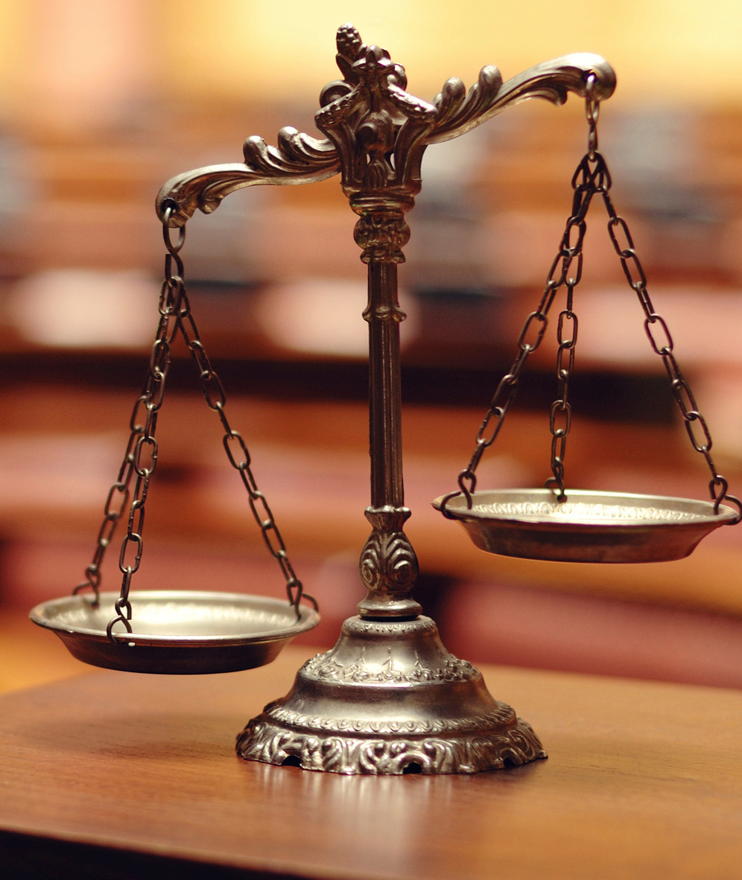
The Judicial System
The judiciary enforces law
The UK has three separate legal systems:
  England and Wales
  Scotland
  Northern Ireland

