Slide 1
Know Your Rights - Module IIII: Schedule 7
01
MEND KNOW YOUR RIGHTS 2021
Notes:
Min Title Page

Slide 2
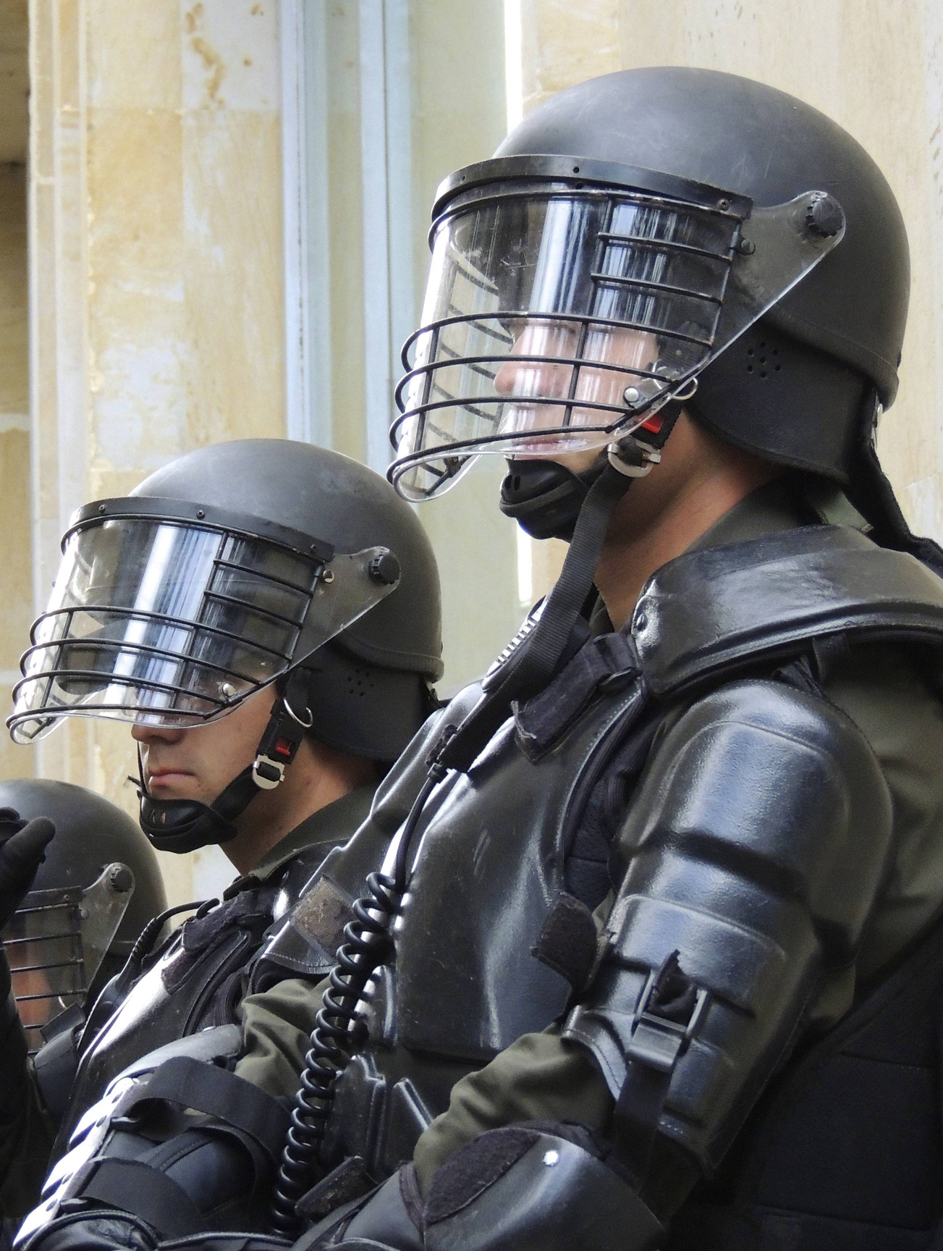
Overview
01. What is Schedule 7?
Notes:
Contents Page

Slide 3
Overview
01. What is Schedule 7?
02. What is the Procedure?

Slide 4
Overview
01. What is Schedule 7?
02. What is the Procedure?
03. What Rights do People Have?

Slide 5
Activity
What do you know about Schedule 7?

Slide 6
01
What is Schedule 7?
KNOW YOUR RIGHTS - SCHEDULE 7
Notes:
Slide with Content

Slide 7
01
What is Schedule 7?
Schedule 7 is a provision under the Counter-Terror Act 2000
It also "forms a key part of the UK's border security arrangements"
KNOW YOUR RIGHTS - SCHEDULE 7

Slide 8
Schedule 7 gives police constables and immigration officials the power to:
KNOW YOUR RIGHTS - SCHEDU;E 7

Slide 9
Schedule 7 gives police constables and immigration officials the power to:
SEARCH
KNOW YOUR RIGHTS - SCHEDU;E 7

Slide 10
Schedule 7 gives police constables and immigration officials the power to:
SEARCH
INTERROGATE
KNOW YOUR RIGHTS - SCHEDU;E 7

Slide 11
Schedule 7 gives police constables and immigration officials the power to:
SEARCH
INTERROGATE
DETAIN
KNOW YOUR RIGHTS - SCHEDU;E 7

Slide 12
Schedule 7 gives police constables and immigration officials the power to:
SEARCH
INTERROGATE
DETAIN
at
AIRPORTS
KNOW YOUR RIGHTS - SCHEDU;E 7

Slide 13
Schedule 7 gives police constables and immigration officials the power to:
SEARCH
INTERROGATE
DETAIN
at
AIRPORTS
SEAPORTS
KNOW YOUR RIGHTS - SCHEDU;E 7

Slide 14
Schedule 7 gives police constables and immigration officials the power to:
SEARCH
INTERROGATE
DETAIN
at
AIRPORTS
SEAPORTS
KNOW YOUR RIGHTS - SCHEDU;E 7
LAND BORDERS

Slide 15
Schedule 7 gives police constables and immigration officials the power to:
SEARCH
INTERROGATE
DETAIN
at
AIRPORTS
SEAPORTS
KNOW YOUR RIGHTS - SCHEDU;E 7
LAND BORDERS
INTERNATIONAL TRAIN PORTS

Slide 16
Schedule 7 also gives police and immigration officials the power to take your :
KNOW YOUR RIGHTS - SCHEDU;E 7

Slide 17
Schedule 7 also gives police and immigration officials the power to take your :
FINGERPRINTS
KNOW YOUR RIGHTS - SCHEDU;E 7

Slide 18
Schedule 7 also gives police and immigration officials the power to take your :
FINGERPRINTS
PHOTOS
KNOW YOUR RIGHTS - SCHEDU;E 7

Slide 19
Schedule 7 also gives police and immigration officials the power to take your :
FINGERPRINTS
PHOTOS
DNA
KNOW YOUR RIGHTS - SCHEDU;E 7

Slide 20
02
How Does Schedule 7 Function?
KNOW YOUR RIGHTS - SCHEDU;E 7

Slide 21
02
How Does Schedule 7 Function?
“Schedule 7 is a national security port and border power. It enables an examining officer to STOP, SEARCH, QUESTION & DETAIN a person travelling through a port/airport or the border area.”
2020. Assets.Publishing.Service.Gov.Uk. Accessed March 23.
ttps://assets.publishing.service
KNOW YOUR RIGHTS - SCHEDU;E 7

Slide 22
KNOW YOUR RIGHTS - SCHEDU;E 7

Slide 23
POLICE CONSTABLE
KNOW YOUR RIGHTS - SCHEDU;E 7

Slide 24
POLICE CONSTABLE
KNOW YOUR RIGHTS - SCHEDU;E 7
CUSTOMS OFFICER

Slide 25
POLICE CONSTABLE
KNOW YOUR RIGHTS - SCHEDU;E 7
CUSTOMS OFFICER
IMMIGRATION OFFICER

Slide 26
STOPPED
KNOW YOUR RIGHTS - SCHEDU;E 7

Slide 27
STOPPED
You are not a suspect.
KNOW YOUR RIGHTS - SCHEDU;E 7

Slide 28
STOPPED
You are not a suspect.
However, what an individual says can be used to incriminate them or others.
Officers don't need reasonable cause or suspicion to stop you.
KNOW YOUR RIGHTS - SCHEDU;E 7

Slide 29
02
Schedule 7 Success Rates
KNOW YOUR RIGHTS - SCHEDU;E 7

Slide 30
02
Schedule 7 Success Rates
The way that data is recorded regarding Schedule 7 makes it difficult to accurately assess how many people have been affected.
CAGE found that, of the 419,000 people stopped under Schedule 7 since 2009, only 30 were convicted
KNOW YOUR RIGHTS - SCHEDU;E 7

Slide 31
What is the Process of a Schedule 7 Stop?
03
KNOW YOUR RIGHTS - SCHEDULE 7

Slide 32
Screening
KNOW YOUR RIGHTS - SCHEDULE 7

Slide 33
Screening
This involves simple questions regarding your identity and the reason for travelling
KNOW YOUR RIGHTS - SCHEDULE 7

Slide 34
Examination
KNOW YOUR RIGHTS - SCHEDULE 7

Slide 35
Examination
•This can take up to an hour
•You may undergo this process
following screening
•You must be informed that you are being examined and be given an information leaflet
KNOW YOUR RIGHTS - SCHEDULE 7

Slide 36
Detention
KNOW YOUR RIGHTS - SCHEDULE 7

Slide 37
Detention
•If they need to question you for longer than an hour, they will extend to the third phase of detention
•They must give you a ‘Notice of Detention’.
•
•Total time held, including examination, cannot exceed 6 hours
KNOW YOUR RIGHTS - SCHEDULE 7

Slide 38
What Can be Taken/Asked of you Under Schedule 7?
04
KNOW YOUR RIGHTS - SCHEDULE 7

Slide 39
• Right to remain silent?
KNOW YOUR RIGHTS - SCHEDULE 7

Slide 40
• Right to remain silent?
• Document and information.
KNOW YOUR RIGHTS - SCHEDULE 7

Slide 41
• Right to remain silent?
• Document and information.
• DNA, fingerprints and photographs.
KNOW YOUR RIGHTS - SCHEDULE 7

Slide 42
• Right to remain silent?
• Document and information.
• DNA, fingerprints and photographs.
• Phones, tablets and laptops
KNOW YOUR RIGHTS - SCHEDULE 7

Slide 43
• Right to remain silent?
• Document and information.
• DNA, fingerprints and photographs.
• Phones, tablets and laptops
• Passwords and encryption keys.
KNOW YOUR RIGHTS - SCHEDULE 7

Slide 44
What Cannot be Taken/Asked of you Under Schedule 7?
05
KNOW YOUR RIGHTS - SCHEDULE 7

Slide 45
• Behaviour of other people.
KNOW YOUR RIGHTS - SCHEDULE 7

Slide 46
• Behaviour of other people.
• MI5.
KNOW YOUR RIGHTS - SCHEDULE 7

Slide 47
• Behaviour of other people.
• MI5.
•Your DNA, fingerprints, and intimate samples
KNOW YOUR RIGHTS - SCHEDULE 7

Slide 48
• Behaviour of other people.
• MI5.
•Your DNA, fingerprints, and intimate samples
• Searched by a person of the same gender.
KNOW YOUR RIGHTS - SCHEDULE 7

Slide 49
• Behaviour of other people.
• MI5.
•Your DNA, fingerprints, and intimate samples
• Searched by a person of the same gender.
• Recruited as an informer on members of your community.
KNOW YOUR RIGHTS - SCHEDULE 7

Slide 50
Your Right to Representation
KNOW YOUR RIGHTS - SCHEDULE 7

Slide 51
Your Right to Representation
•As long as you have not been formally detained, you can “request legal advice at your own expense.”
•You may be able to notify someone of your examination, but if you are subsequently detained you will have the right to have someone notified.
KNOW YOUR RIGHTS - SCHEDULE 7

Slide 52
Consequences of Non-Cooperation
KNOW YOUR RIGHTS - SCHEDULE 7

Slide 53
Consequences of Non-Cooperation
“An officer has the power to detain you, using reasonable force if necessary. You commit an offence if you willfully fail to comply with a request made by an officer under this legislation. This could result in a prison sentence, a fine or both.”
2020. Npcc.Police.Uk. Accessed March 23. https://www.npcc.police.uk/Schedule%207/Schedule%207%20Public%20Information%20Leaflet.pdf.
KNOW YOUR RIGHTS - SCHEDULE 7

Slide 54
How to Handle the Situation
KNOW YOUR RIGHTS - SCHEDULE 7

Slide 55
How to Handle the Situation
Politely cooperate.
KNOW YOUR RIGHTS - SCHEDULE 7

Slide 56
How to Handle the Situation
Politely cooperate.
Take the steps of making sure you are aware of your rights.
KNOW YOUR RIGHTS - SCHEDULE 7

Slide 57
How to Handle the Situation
Politely cooperate.
Take the steps of making sure you are aware of your rights.
Ask for a pen and paper
KNOW YOUR RIGHTS - SCHEDULE 7

Slide 58
How to Handle the Situation
Politely cooperate.
Take the steps of making sure you are aware of your rights.
Ask for a pen and paper
Keep a detailed account of the events.
KNOW YOUR RIGHTS - SCHEDULE 7

Slide 59
How to Handle the Situation
Politely cooperate.
Take the steps of making sure you are aware of your rights.
Ask for a pen and paper
Keep a detailed account of the events.
Note down the types of questions they asked, as well as the responses you gave.
KNOW YOUR RIGHTS - SCHEDULE 7

Slide 60
How to Handle the Situation
• Being stopped is not indicative of wrongdoing, and you aren’t suspected of committing a crime.
KNOW YOUR RIGHTS - SCHEDULE 7

Slide 61
How to Handle the Situation
• Being stopped is not indicative of wrongdoing.
• You are likely to be quizzed on almost every aspect of your life.
KNOW YOUR RIGHTS - SCHEDULE 7

Slide 62
CASE STUDY:
The Aid Worker Who Got Stopped, Then Approached by MI5.
KNOW YOUR RIGHTS - SCHEDULE 7

Slide 63
CASE STUDY:
The Aid Worker Who Got Stopped, Then Approached by MI5.
In 2017 I was stopped three times under Schedule 7 on different trips in the space of three months.
KNOW YOUR RIGHTS - SCHEDULE 7

Slide 64
CASE STUDY:
The Aid Worker Who Got Stopped, Then Approached by MI5.
In 2017 I was stopped three times under Schedule 7 on different trips in the space of three months.
Some months later I had another stop in which they claimed it was a Schedule 7 stop but it wasn’t a Schedule 7 stop, it was Mi5.
KNOW YOUR RIGHTS - SCHEDULE 7

Slide 65
CASE STUDY:
The Aid Worker Who Got Stopped, Then Approached by MI5.
In 2017 I was stopped three times under Schedule 7 on different trips in the space of three months.
Some months later I had another stop in which they claimed it was a Schedule 7 stop but it wasn’t a Schedule 7 stop, it was Mi5.
Literally the moment I step off the plane, the men in suits are at the bottom of the stairs, waiting for me.
KNOW YOUR RIGHTS - SCHEDULE 7

Slide 66
What To Do If You Need to Complain
KNOW YOUR RIGHTS - SCHEDULE 7

Slide 67
What To Do If You Need to Complain
•CAGE
CAGE have specialised personnel and resources committed to dealing with Schedule 7 cases since its founding.
KNOW YOUR RIGHTS - SCHEDULE 7

Slide 68
What To Do If You Need to Complain
•CAGE
CAGE have specialised personnel and resources committed to dealing with Schedule 7 cases since its founding.
•Speak to your MP
KNOW YOUR RIGHTS - SCHEDULE 7

