Slide 1
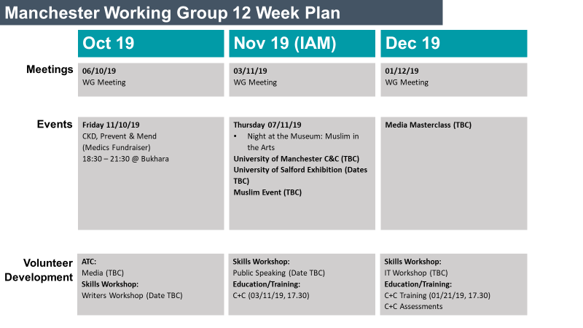
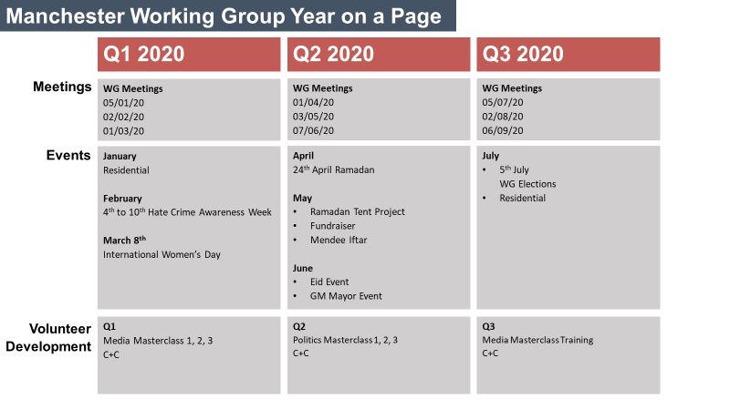
User Guide
The document should not be used as a project plan, but as a long term activity planner.
This long term plan is split into two slides:
First slide: Provides higher level of detail of activity for the quarter you are currently in
Second slide: Provides an overview of the succeeding three quarters
The resource aims to be a rolling document where more detail is added as it is confirmed. Quarters should be phased out once they have passed. New quarters should be added at three month intervals.
The document should be updated for each monthly WG meeting and sent out to volunteers.
It would also be good practice to include the name of the volunteer lead taking ownership of each activity to foster key developmental skills.
An example of the activity plan in practice can be seen to the right.
First slide
Second slide
Prepared by Shafiuddean Choudry

Slide 2
XXXXXXX Working Group 12 Week Plan
Month 1
Month 2
Month 3
Meetings
DATE Type of Meeting (e.g. WG, Strategy etc)
DATE Type of Meeting (e.g. WG, Strategy etc)
DATE Type of Meeting (e.g. WG, Strategy etc)
Events
DAY and DATE Name of Event Time and Location
DAY and DATE Name of Event Time and Location
DAY and DATE Name of Event Time and Location
DAY and DATE Name of Event Time and Location
DAY and DATE Name of Event Time and Location
DAY and DATE Name of Event Time and Location
Volunteer Development
ATC:
Subject/Date/Time/Location
Education/Training:
Subject/Date/Time/Location
ATC:
Subject/Date/Time/Location
Education/Training:
Subject/Date/Time/Location
ATC:
Subject/Date/Time/Location
Education/Training:
Subject/Date/Time/Location
Prepared by Shafiuddean Choudry

Slide 3
XXXXXXX Working Group Year on a Page
Q[x] Year
Q[x] Year
Q[x] Year
Meetings
WG Meetings Date
Date
Date
WG Meetings Date
Date
Date
WG Meetings Date
Date
Date
Events
Month 1 Activity/Campaign Month 2 Activity/Campaign Month 3 Activity/Campaign
Month 1 Activity/Campaign Month 2 Activity/Campaign Month 3 Activity/Campaign
Month 1 Activity/Campaign Month 2 Activity/Campaign Month 3 Activity/Campaign
Volunteer Development
Month
Activity (e.g. ATC, C+C, Masterclass)
Month
Activity (e.g. ATC, C+C, Masterclass)
Month
Activity (e.g. ATC, C+C, Masterclass)
Prepared by Shafiuddean Choudry

