Slide 1


Slide 2
IAM 2020
        Introduction
        Strategy
        Key Activities
        Planning Checklist

Slide 3
What is Islamophobia Awareness Month (IAM)?
Islamophobia Awareness Month (IAM) was co-founded by MEND in 2012 to deconstruct and challenge the stereotypes surrounding Islam and Muslims.
The month-long campaign, held every November, aims to work with Police and Crime Commissioners (PCC), local councils, journalists and local media outlets, councillors and local MPs, mosques, universities, schools, community organisations, and others to raise awareness of the scourge of Islamophobia and encourage better reporting of incidents to the police.
Notes:
Eman – 3 part series

Slide 4
Objectives
To highlight the scourge of Islamophobia in society
To promote the positive contributions of Muslims in the UK
Notes:
Eman – 3 part series

Slide 5
Strategy
In light of COVID19 we have made the early decision that this years IAM campaign will solely be a online virtual campaign for the following reasons:
There is the fear that in the winter there will be a second peak of COVID cases
Even if COVID restrictions are lifted it is unlikely that large gatherings will be permitted
The public mood may be such that physical events will struggle to get good attendance levels
Notes:
Eman – 3 part series

Slide 6
Strategy – Key Elements
Everything will go online on our various social media platforms.
We will still look to engage our delivery partners and stakeholders - they will be crucial to our success.
Corporate engagement will involve getting corporates to change their logo’s, hold webinars with their staff members
We will have a social media actions that everyone can get involved in

Slide 7
Key activities
1. Regional Online Launches
2. MEND Online Webinars
3. Partner Orgs Webinars
4. Corporate Engagement
Notes:
1. Each region should organize an online launch for their region
2. MEND online webinars – Each WG should plan online seminars
3. Partner Orgs Webinar – Each WG should identify key partners in their locality (3 Muslims & 3 Non Muslims)
4. Corporate engagement – Each WG should identify local organisations who can hold IAM online events

Slide 8
Timeline
June
July
Aug
Sep
Oct
Nov
Dec
Theme
WG planning
Get partners on board with us
Book speakers / Stakeholders
Poster designing
IAM launch
IAM Report
Share strategy
Plan digital marketing
Webinar hosting training
Partner Events
Celebration
MEND events
Social Media action

Slide 9
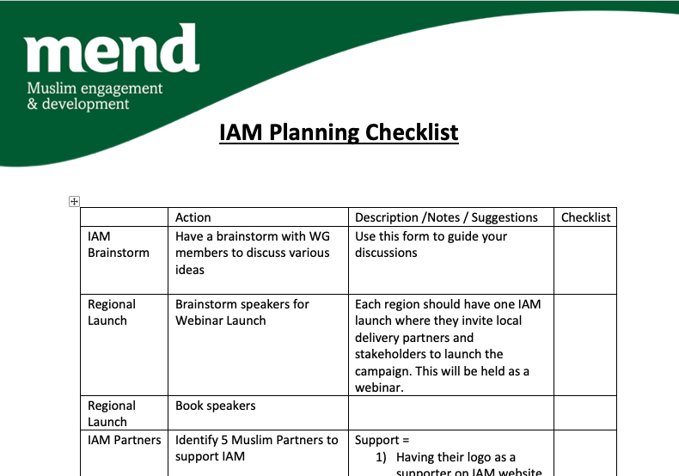
Planning Checklist

