Slide 2
Notes:
Everybody please take out your mobile phones
Go to Facebook and like our page
www.facebook.com/mendcommunity
Twitter.com/mendcommunity
Instagram/mendcommunity
Youtube/MendCommunity
Hashtag #MendEvent

Slide 3
Notes:
Everybody please take out your mobile phones
Go to Facebook and like our page
www.facebook.com/mendcommunity
Twitter.com/mendcommunity
Instagram/mendcommunity
Youtube/MendCommunity
Hashtag #MendEvent

Slide 4
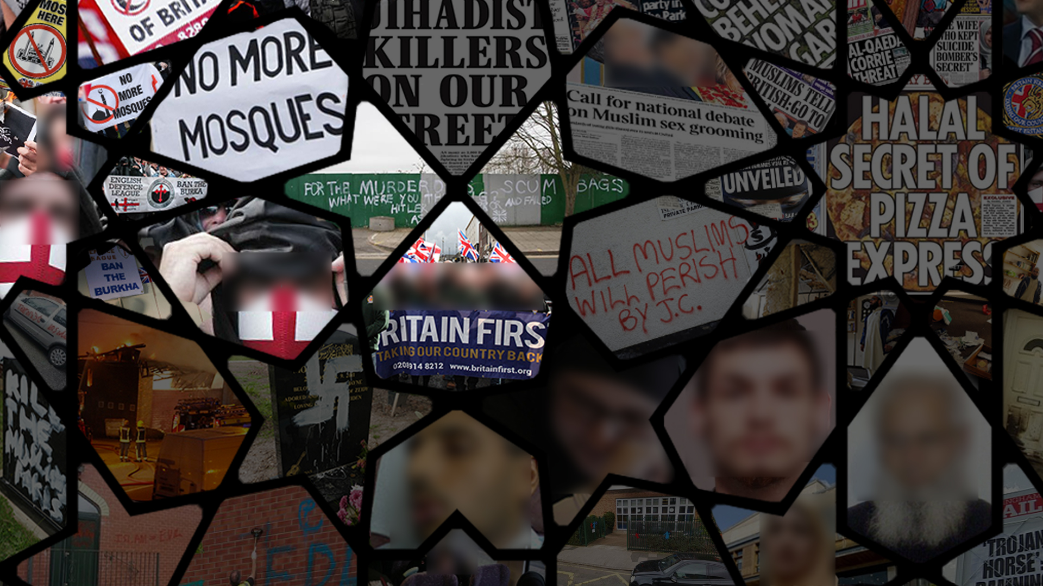
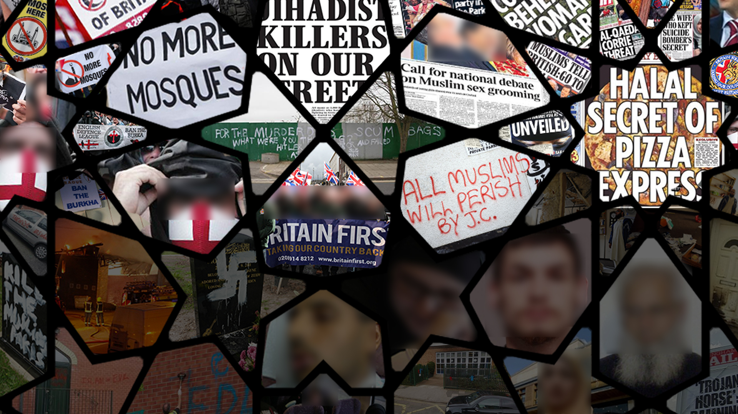
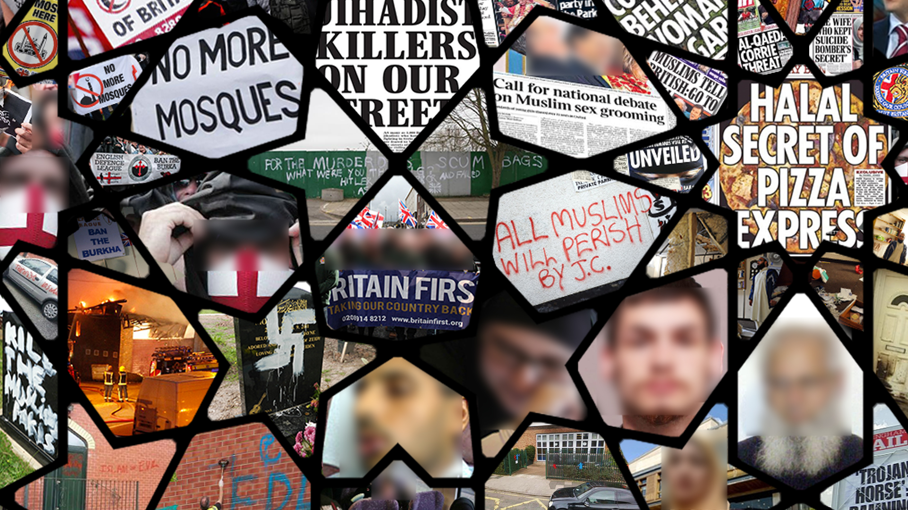
Notes:
In July 2006, Naeem Mohammad, assistant imam at the Islamic Cultural Centre in Rhyl, North Wales lost two teeth and needed 15 stitches when he was assaulted by two men who stopped him in the street and asked him his religion , and then attacked him when he gave the “wrong” answer - http://news.bbc.co.uk/1/hi/wales/north_east/5169800.stm ?
-
Islamic Relief, HQ in Glasgow, arson attack, April 2010 -
EDL protest on roof of proposed mosque site in Dudley, May 2010 - http://lancasteruaf.blogspot.co.uk/2010/05/roof-top-protest-after-english-defence.html
Tarleton Community Primary School, Hesketh, Lancashire - http://news.bbc.co.uk/1/hi/england/lancashire/4693371.stm
High Wycombe, Muslim graves desecrated April 2011 - http://www.iengage.org.uk/component/content/article/1-news/1332-muslim-graves-attacked-in-high-wycombe-cemetery
Cradley Heath mosque, burnt to the ground, Dec 2009 - http://www.iengage.org.uk/component/content/article/1-news/698-muslims-appeal-for-help-as-arsonists-strike-again-and-burn-mosque-to-the-ground
Zahra Kazemi-Saelh, British-Iranian schoolgirl, attacked by girls who tried to remove her headscarf, April 2011
Mohamed Saleem Chaudhry – 82 year old grandfather stabbed to death on way back from mosque in Midlands
Hasina Khan – Muslim woman spat on in Bristol city centre by a man who raged at her about Muslims ‘killing Christians in the Middle East
Kirkcaldy Islamic Centre, vandalised in July 2013 with the words ‘All Muslims will perish’ – cars in the Centre’s car park were vandalised with crosses spray painted on them
Muslim section of Christchurch cemetery in Newport , Wales, vandalised in July 2013 with ‘Kill the Muslim Pakis’ and swastikas sprayed onto headstones
Bravenese Somali Islamic Centre in Muswell Hill, London – partially burnt to the ground days after Lee Rigby’s murder with the letters EDL painted on one of the walls. Police investigation into the incident is ongoing.
Muhsin ahmed rotherham, 81 year old pensioner attacked after Fajr

Slide 5
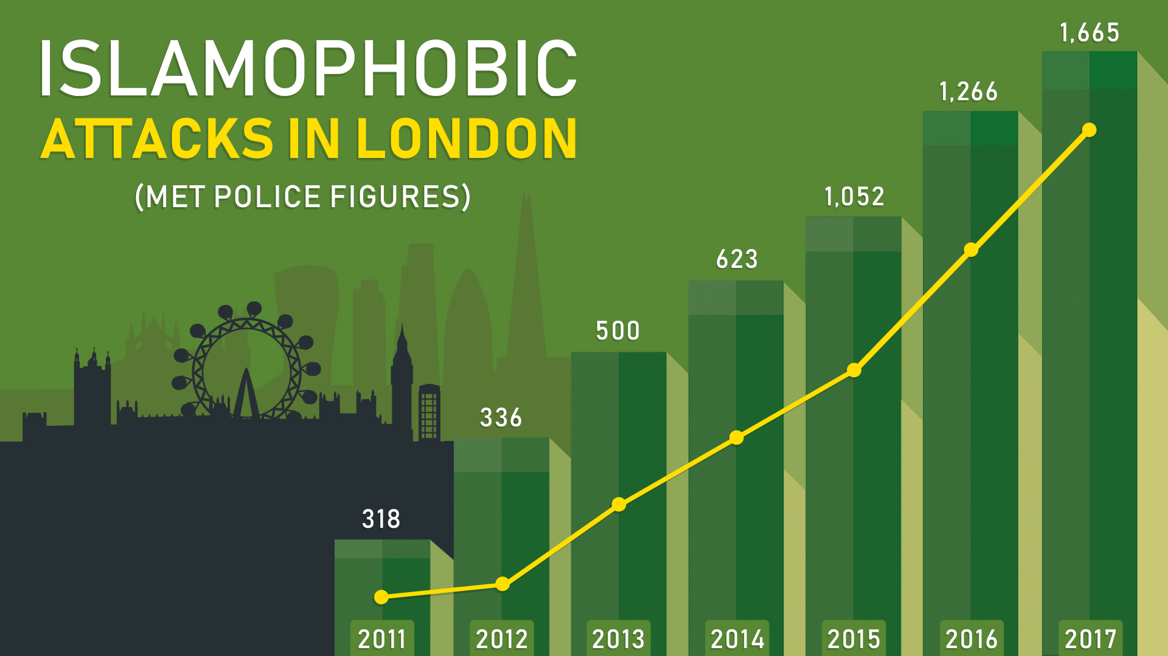

Slide 6
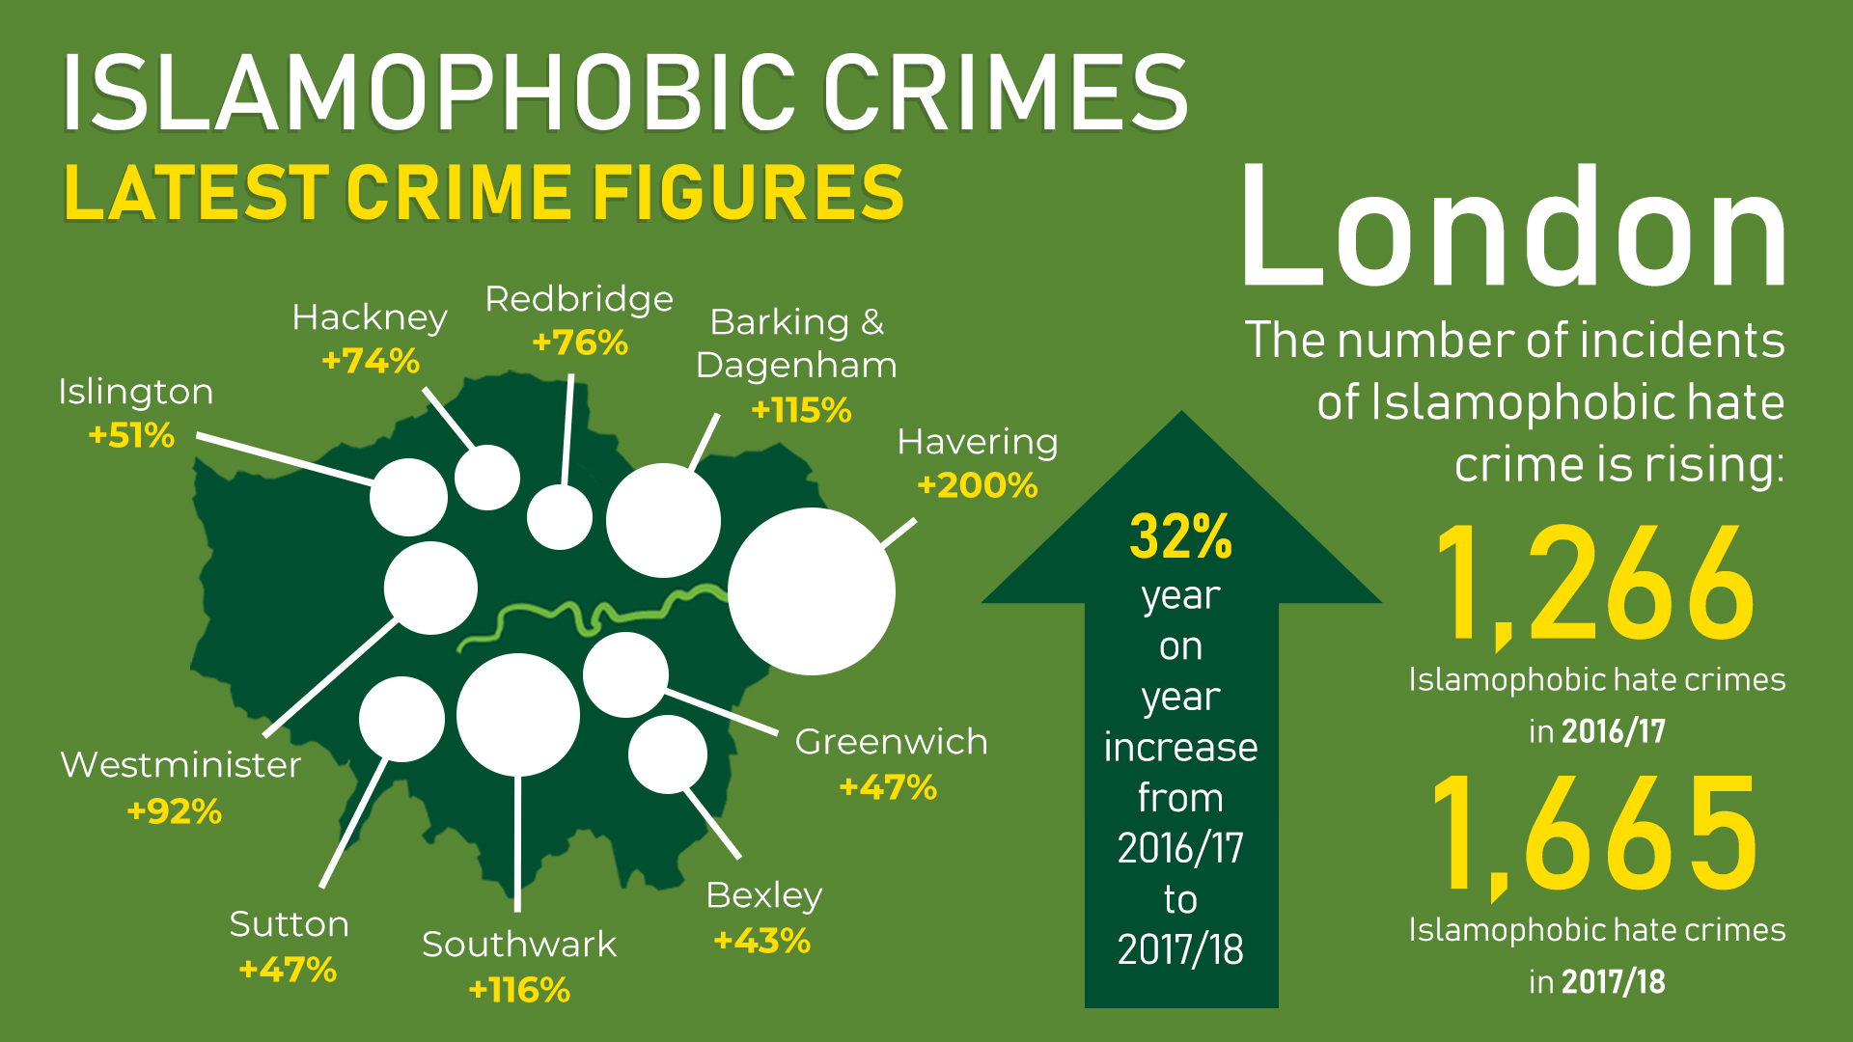
Notes:
Presenters should begin with the fact that overall Islamophobic crime has increased 65%! After this take the participants through the interesting stats.
Two council districts with the highest Muslim populations in the country – Tower Hamlets (34.5%) and Newham (32%) – appear on the list, with substantial increases at both 144.1% and 91.7% respectively.
Haringey also has a sizeable Muslim minority at 14.2%, the rate of increase here is the highest in London at 217.6%.
Similarly, Ealing, with Muslims making up 15.7% of the population, saw the second highest increase at 171.4%.

Slide 7
Notes:
KEY CAUSES
BIASED MEDIA REPORTING
INEFFECTIVE LEGISLATION
LACK OF MUSLIM PARTICIPATION

Slide 9
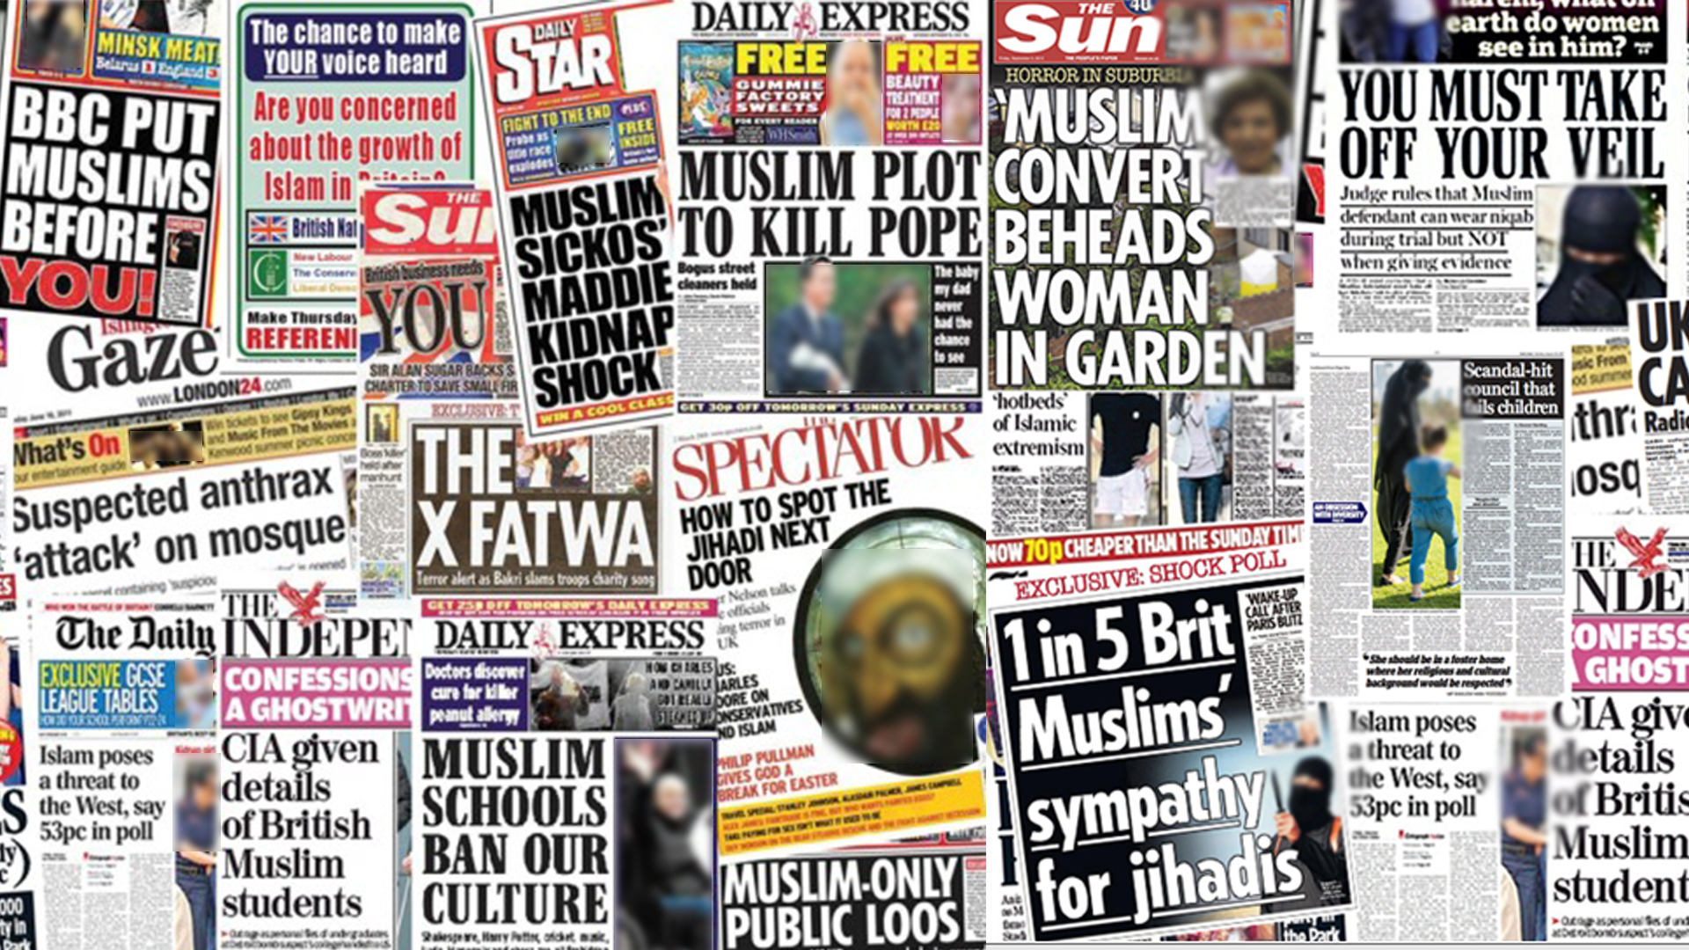

Slide 10
Notes:
Note how relatively infrequently Muslims are portrayed as ordinary people as businessmen, teachers etc, and how the discourse is dominated by the framing of Islam and Muslims around the key themes of conflict, violence and terrorism.

Slide 11
Notes:
These more contemporary pieces of information can be added to the slide as an update to illustrate the pervasiveness of Islamophobic attitudes in public opinion. These statistics suggest that far received wisdom that its Muslims who have a problem, or Muslims who have rejected British society, the reverse is true. Muslims have been rejected.
The information about these attitudes among supporters of mainstream political parties is possibly equally, if not more worrying because we live in a representative democracy. These views are increasingly finding a sympathetic ear among politicians eager to gain political mileage, and please the public, which could have negative long-term implications for Muslims in the UK.
YouGov. (2015). After Paris: The surprising resilience of British attitudes. [online] Available at: https://yougov.co.uk/news/2015/12/23/after-paris-surprising-resilience-british-attitude/ [Accessed 16 Nov. 2016].
Smith, M. (2016). Ban the burka, says majority of the British public. [online] YouGov: What the world thinks. Available at: https://yougov.co.uk/news/2016/08/31/majority-public-backs-burka-ban/ [Accessed 16 Nov. 2016].
MEND. (2015). Islam and "British values" - do Brits believe them to be compatible? - MEND. [online] Available at: http://mend.org.uk/islam-and-british-values-do-brits-believe-them-to-be-compatible/ [Accessed 30 Nov. 2016].
MEND. (2015). Islam and "British values" - do Brits believe them to be compatible? - MEND. [online] Available at: http://mend.org.uk/islam-and-british-values-do-brits-believe-them-to-be-compatible/ [Accessed 30 Nov. 2016].

Slide 13
Notes:
This only applies to Islam and Muslims in general and not to individual hate crime which is covered by other legislation such as Public Order Act & Crime & Disorder Act

Slide 14
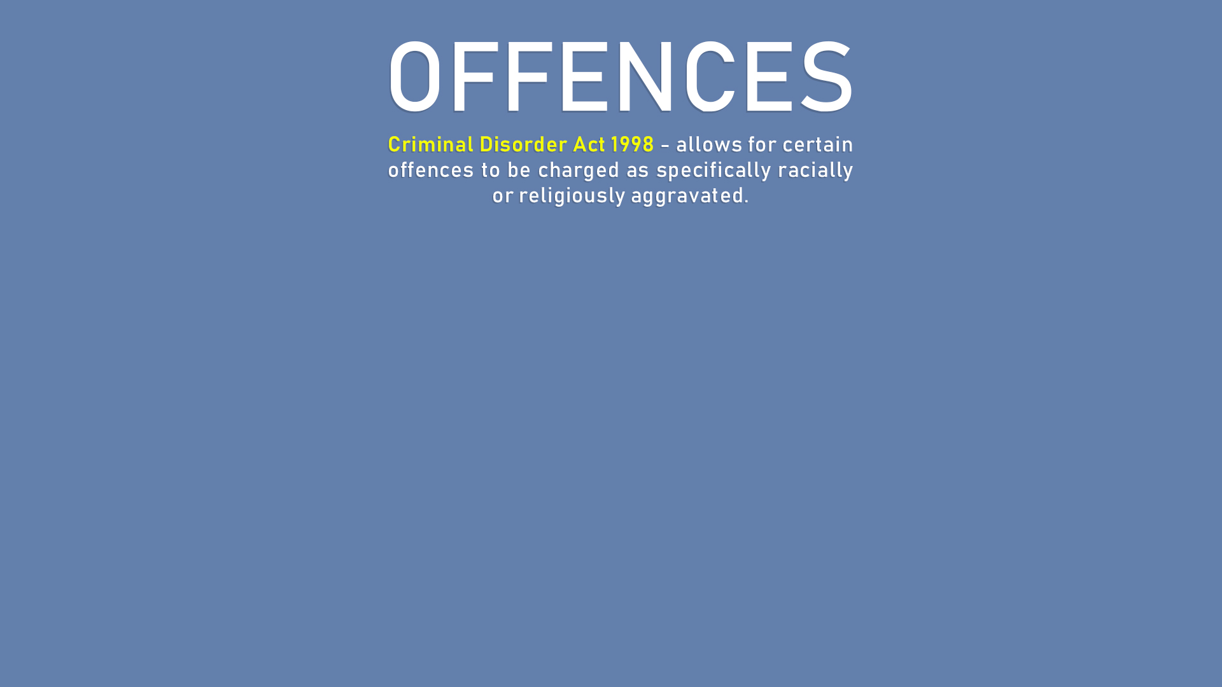

Slide 15
Notes:
SOCIAL MEDIA

Slide 16
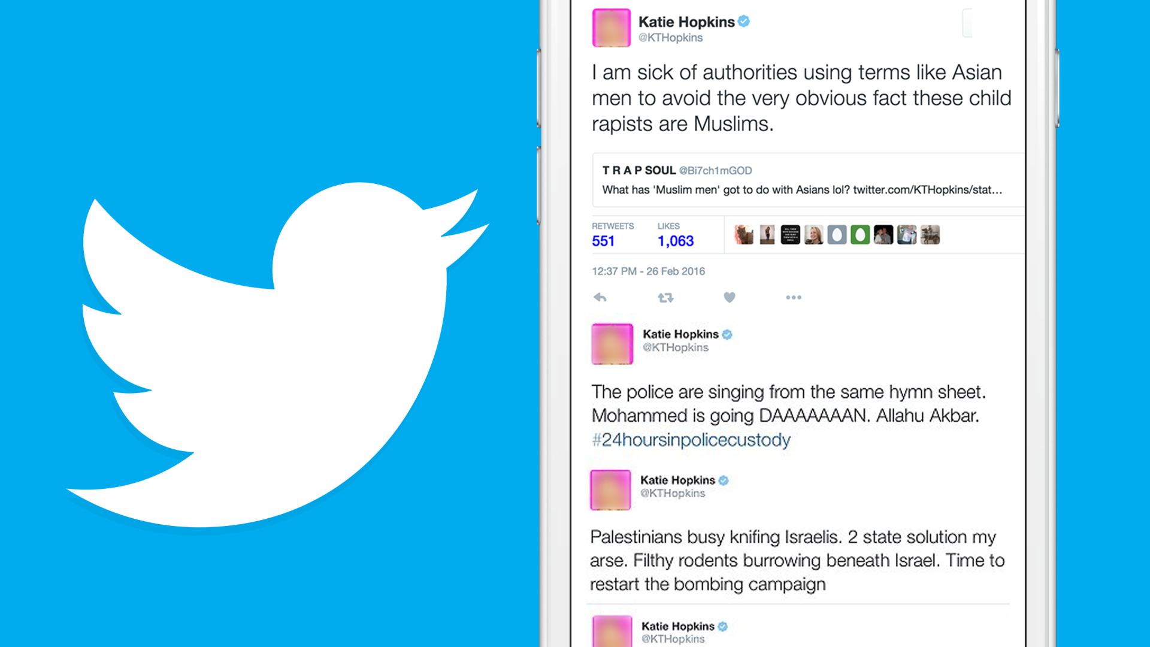

Slide 18
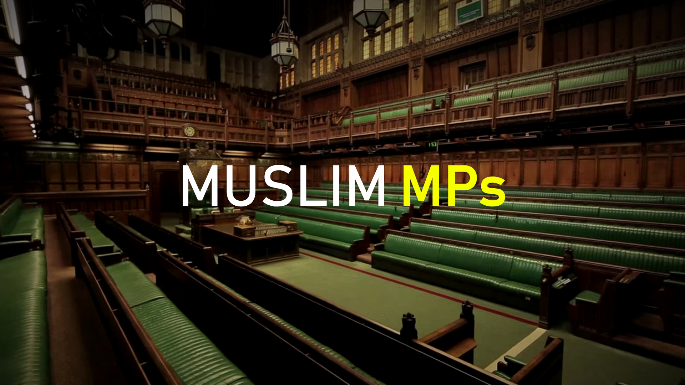
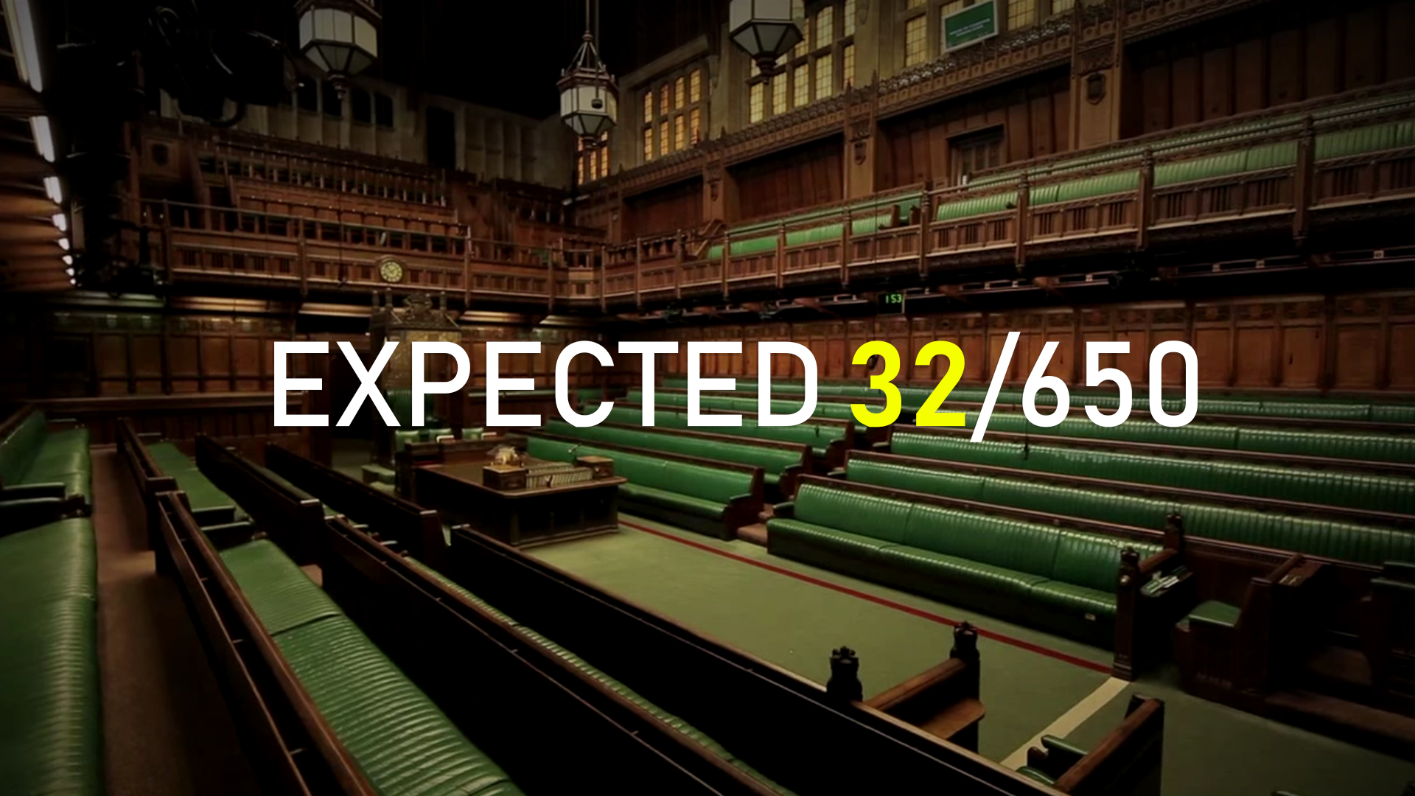
Notes:
Put expected 32/650 (for context: there are 52 ethnic minority MPs – 8% of the total – to proportionally match the BME population there should be 88 BME MPs)

Slide 19
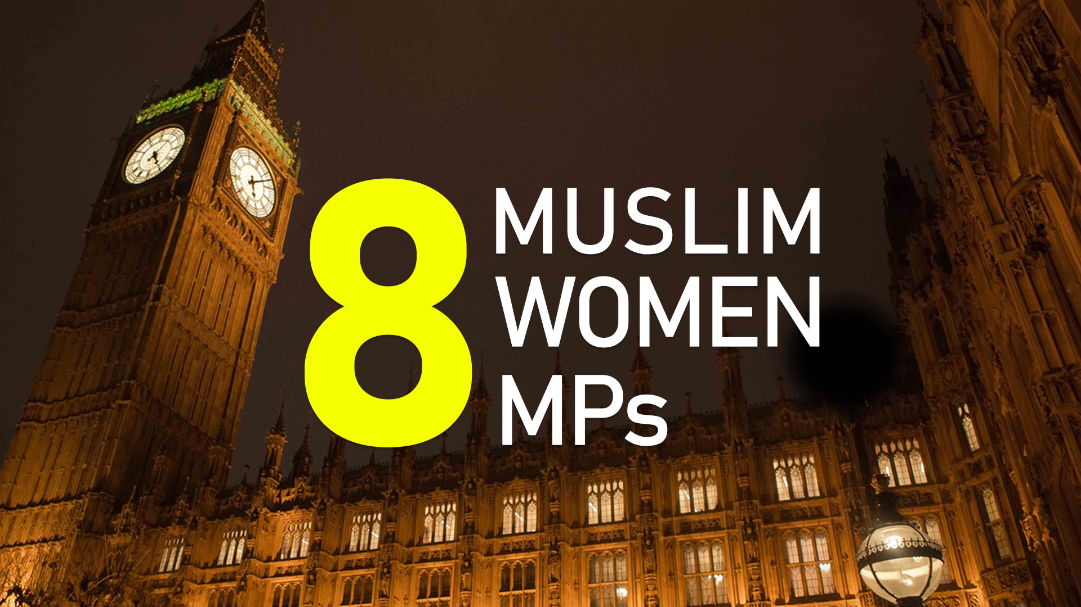
Notes:
Pitt, B. (2014). The Economist defends right to incite religious hatred. [online] Islamophobia Watch. Available at: http://www.islamophobiawatch.co.uk/the-economist-defends-right-to-incite-religious-hatred/ [Accessed 2 Dec. 2016].
Pitt, B. (2010). Religious hatred law once again shown to be useless | Islamophobia Watch. [online] Islamophobiawatch.co.uk. Available at: http://www.islamophobiawatch.co.uk/religious-hatred-law-once-again-shown-to-be-useless-2/ [Accessed 7 Dec. 2016].
The Scotsman. (2015). Record of 13 Muslim MPs elected, 8 of them women. [online] Available at: http://www.scotsman.com/news/uk/record-of-13-muslim-mps-elected-8-of-them-women-1-3768726 [Accessed 17 Nov. 2016].

Slide 20
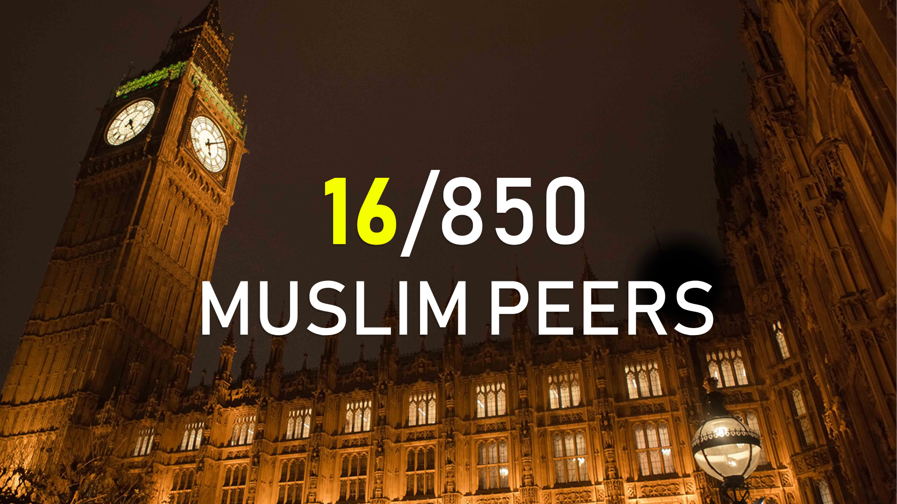
Notes:
In this slide trainers usually scrutinise Muslim participation (or lack thereof), by explaining the discrepancy between the actual number of MPs and the expected. This revision would humanize the vague number 13, by showing those Muslims who have been successful in these fields visually.
Trainers should point to the fact that Muslim women particularly have been very successful – by relative standards to our community, and of course against the wider population – at being elected. Muslim women make up 61% of Muslim elected officials in Westminster, compared with overall where women make up only 29%.
16/850

Slide 21
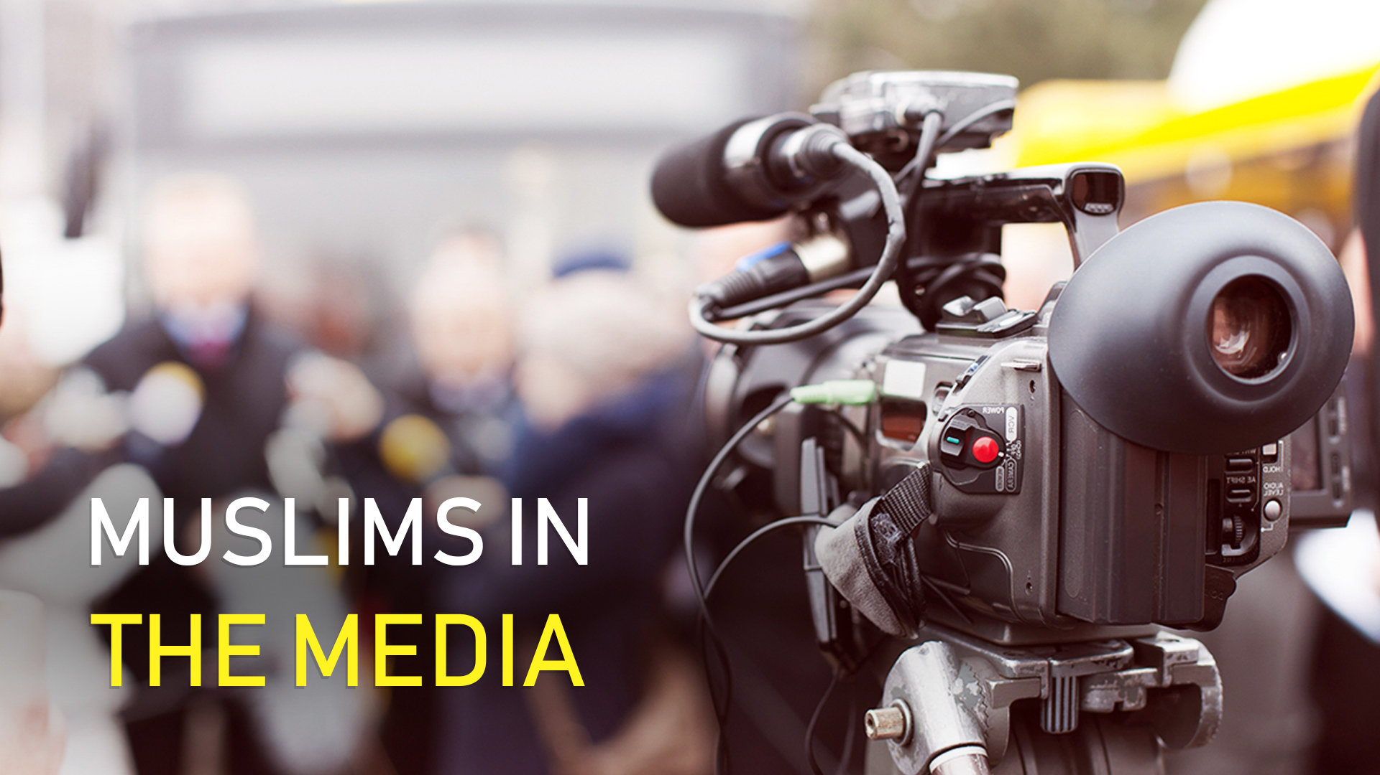
Notes:
Dina Tokio
James Caan
Mohammed Salah
Nadiya Hussain
Moeen Ali
Aleem Iqbal
Guz Khan
Harris J
Riz Ahmed
These Muslims are some new faces we might be able to add to the slide.
Fatima Manji is a British journalist and Newsreader working at Channel 4, she became the first newsreader to wear a hijab.
Adnan Nawaz is a British Pakistani news anchor working currently for the BBC.
Aisha Gani is a senior reporter at BuzzFeed based in London. She writes on a variety of issues ranging from, Islamophobia, contemporary political scandals, and issues, and even history from time to time.
Homa Khaleeli is a staff feature writer for the Guardian.
the Guardian. (2016). Homa Khaleeli | Page 11 of 13 | The Guardian. [online] Available at: https://www.theguardian.com/profile/homa-khaleeli?page=11 [Accessed 21 Nov. 2016].
Mishal Hussain

Slide 22
Notes:
‘READSMART’ INIATIVE (VIA POCKET GUIDE)
ONLINE TOOLS
COMMEND, COMPLAIN & COMMEND
ACTION ALERT
MEDIA TOOLKIT

Slide 24
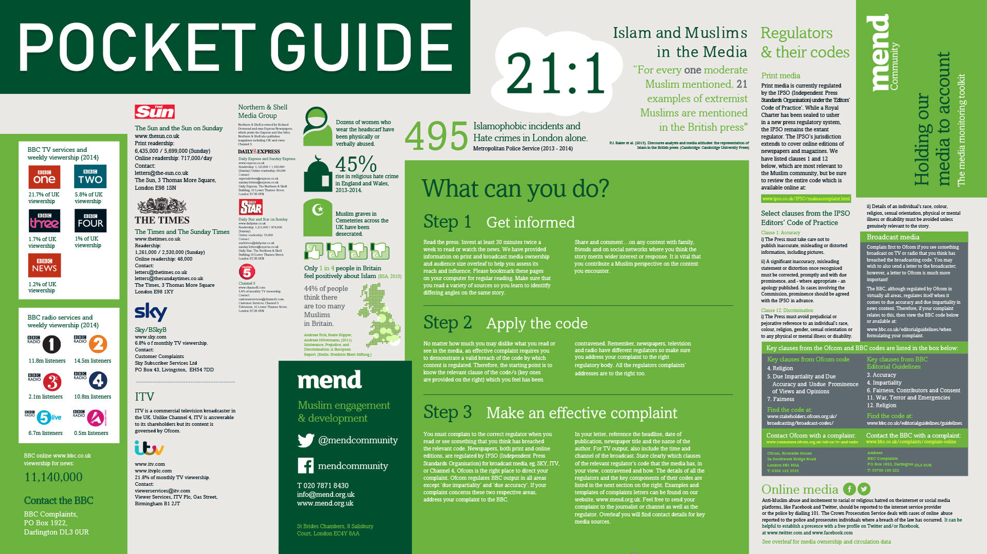
Notes:
POCKET GUIDE
‘READSMART’
-COMMENT
-COMMEND
-COMPLAIN

Slide 25
Notes:
WHAT TO DO AFTER AN INCIDENT

Slide 27
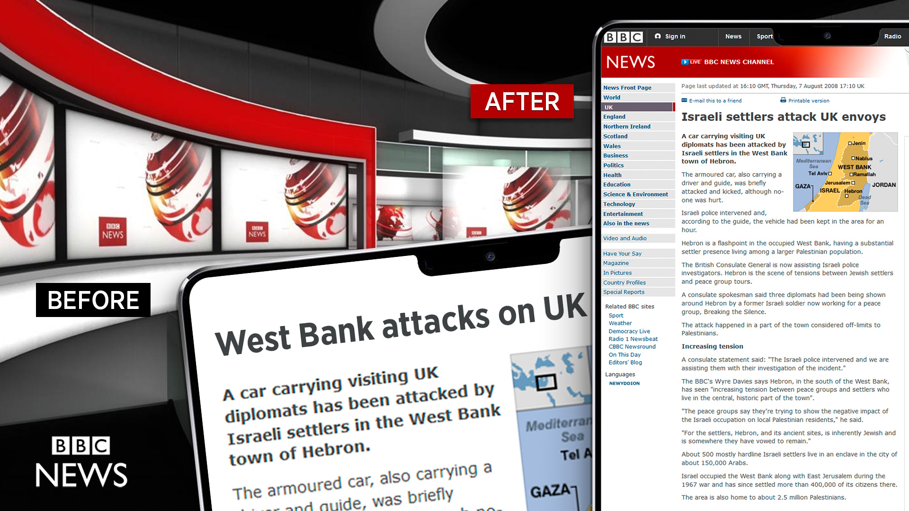
Notes:
Old c&c the sun

Slide 29
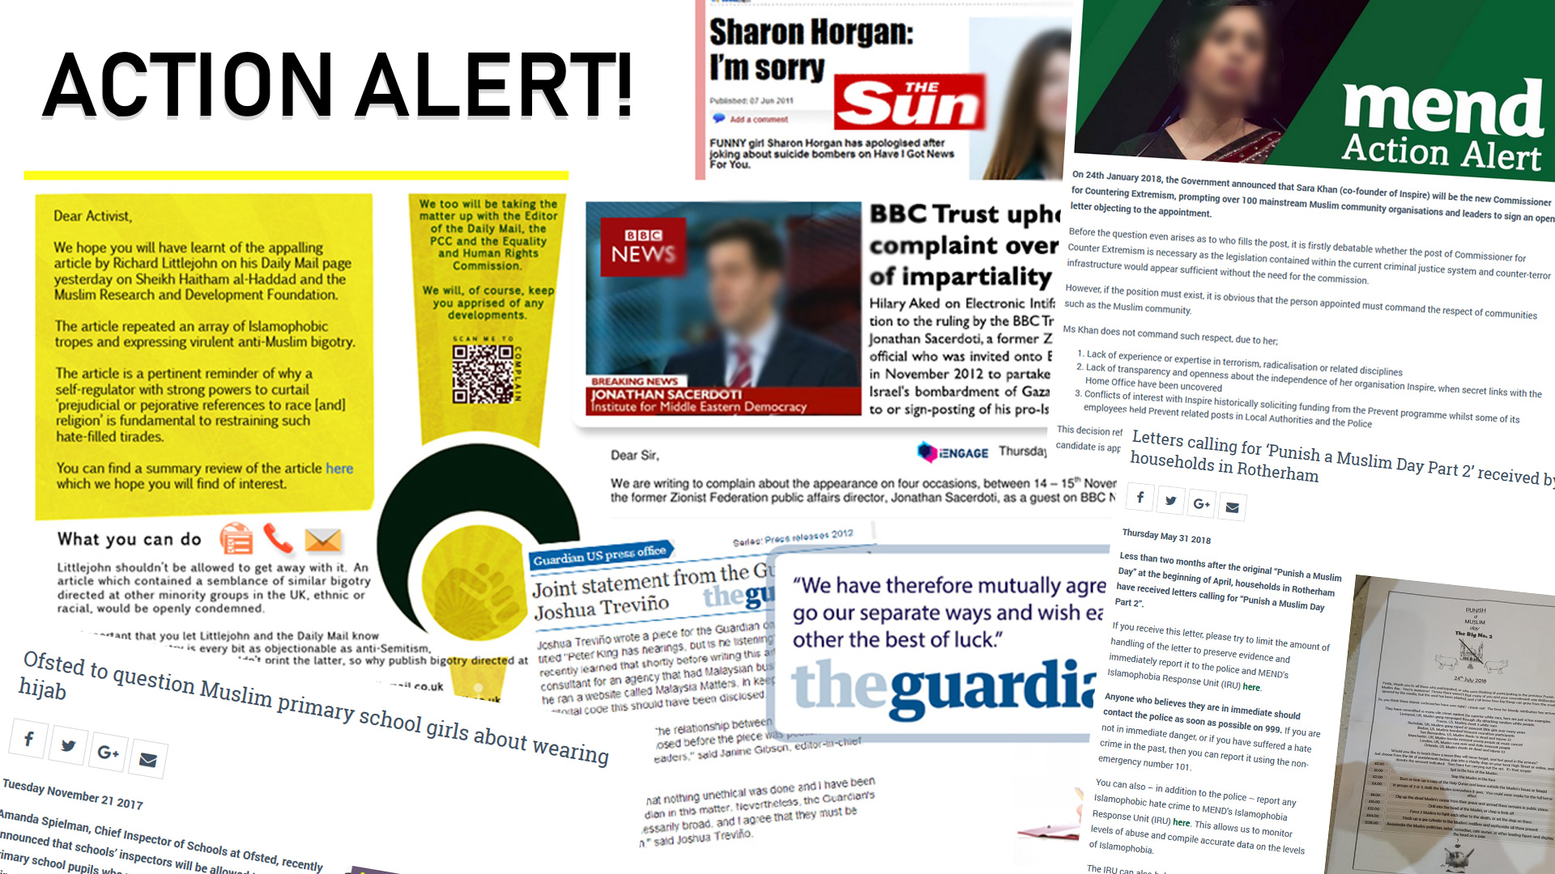

Slide 30
